Slide 1
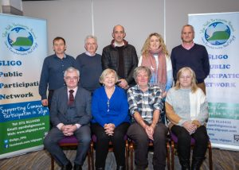
Sligo PPN Online AGM 2020
Overview of 2020 Work and Plans for 2021

Slide 2
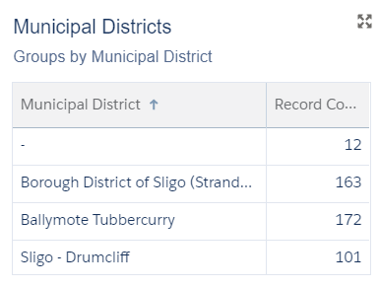
Current PPN Membership
Sligo PPN currently has 437 member groups:
Community & Voluntary Pillar 388 (88.79%)
Environment Pillar 13 (2.97%)
Social Inclusion 36 (8.24%)
Nationally
15,599 Member Groups
928 Representatives on 424 boards
Notes:
A particular welcome to some of our newer member groups including Tubbercurry Development Company

Slide 3
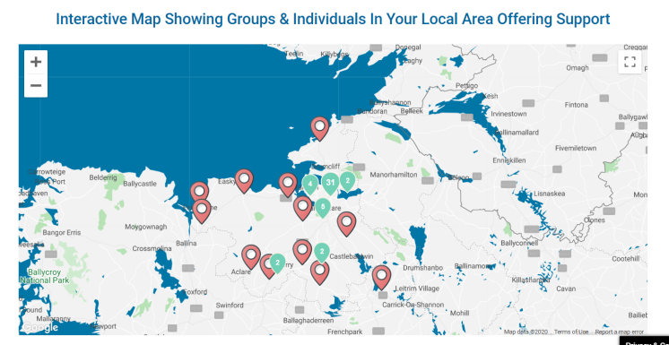
Covid–19 Focussed Actions
Community Mapping
Emergency Response Database
Community Call
Community Forum
Notes:
Because of the PPN’s existing database and connection with community groups, the network was able to immediately reach out to all member groups with a view to forming an Emergency Response Register to support community groups to provide essential services to the most vulnerable in the community.
This process started immediately as lockdown was announced in March and within less than a week 84 groups had registered. This meant that when the official Community Call was launched and Community Forums formed at county level, that in Sligo we were already prepared to be able to work with Sligo County Council to respond to callers as soon as the county helpline was launched. Community groups were incorporated on an interactive map, detailing the services they could provide, as well as listings made available to helpline staff. This effort was reflected across the country and the Department of Community and Rural Development have publicly highlighted the role of PPNs in ensuring the effectiveness of local community coordination.
Sligo Community Response Forum
Sligo PPN were a member of the county community response forum, a collaboration of key local organisations who worked together to coordinate the Covid-19 response at county level. The group was chaired by Sligo County Council Chief Executive Ciarán Hayes. The PPN also sat on a number of working groups with partners such as Sligo Leader, Sligo Co Co and Sligo Volunteer Centre under the forum dealing with issues such as allocating travel permission to volunteers, sourcing and distributing PPE, supporting community group re-opening

Slide 4
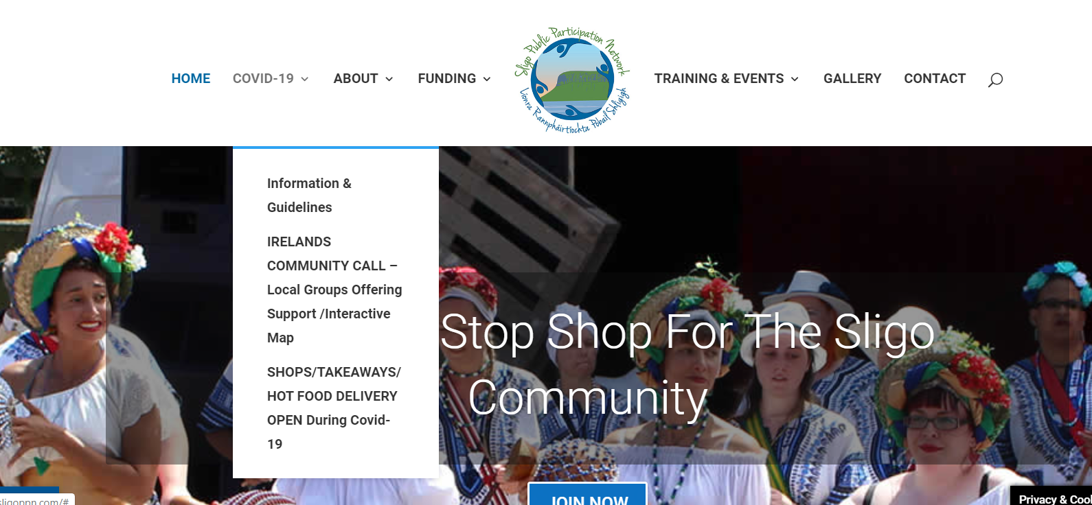
Other Covid-19 Activites
PPN Website – Information Hub
Business Mapping
#Step Up For Sligo
ITSligo research
Notes:
The PPN Website
Over the first lockdown a whole new section was developed within our website dedicated to Covid-19. This contained; up to date, official guidance and information, information on the Sligo Community Response Forum, an interactive map featuring all listed emergency response groups and an interactive map and listing of all open businesses. As the second wave of Covid-19 reached us in October we have been working to try and keep this content as up to date as possible under changing restrictions.
Key Features of the Website
Business mapping – as calls began to come through to the helpline, there was a high demand for information on local businesses and essential services. Sligo PPN worked with Sligo BID and Sligo County Council to map and list key services that were open, noting where possible adaptations to service and amended opening times.
Information Hub – very quickly organisations and community were hit with a barrage of information and often found it hard to know where to look for the advice most suitable to them. Through this site Sligo PPN attempted to pull all information together under a series of key headings.
Step up for Sligo
Sligo PPN were overwhelmed at the immediate and huge response of the Sligo Community to step up and help those most at need as we all adapted to life under Covid-19. While we knew that none of the volunteers who made such a difference in the lives of local people did it for recognition or even thanks, we felt that it was important to try and capture and preserve the huge contribution that the community sector did make as soon as this crisis changed life as we knew it. There is no doubt that the experience of the first lockdown would have been even scarier and isolating, and had more of a negative impact on the health of many people, were it not for the efforts of community volunteers – we believed that this effort should be acknowledged, recorded and kept as a reminder to all. Sligo PPN set up the website Step Up For Sligo (https://stepupforsligo.com/) as a portal for people to send us stories about their experience of volunteering (formally or informally) under Covid-19. The Sligo Champion made contact with the PPN about the project and these stories were translated into a pull out keepsake edition, sponsored by Sligo County Council and Sligo Volunteer Centre
ITSligo
The PPN commissioned ITSligo to undertake a piece of national research looking at the societal and economic impact of volunteering under Covid-19. This was a unique collaboration and we are working with ITSligo on producing the report
Other activity
Facilitated the drop of Nestle food products to support the local Sligo Food Cloud initiative

Slide 5
Non-Covid Related Operations
Promotion of member activities via PPN website, newsletter and social media platforms
Promotion of funding opportunities
Submissions and consultations
Sligo County Council Corporate Plan
Sligo Wayfinding Strategy
DRCD Statement of Strategy
Eirgrid North Connacht 110Kv Project
N17 Knock to Collooney
Notes:
Sligo PPN has a growing social media profile and we work daily to promote the activities of our member groups. We also work to keep our website updated and circulate a quarterly newsletter.
Sligo PPN subscribe to the funding digest developed by The Wheel. We distribute the full digest to all members as well as dissecting the document to promote individual funding rounds as they open. The PPN also works closely with Sligo County Council and Sligo Leader to promote locally administered funding rounds.
Sligo PPN have made a number of submissions to policy and strategy development and have recently hosted and information session on the EirGrid North Connacht project with an upcoming information session on the N17 Knock to Collooney project which will help the community better understand the proposal and how to get their views heard.

Slide 6
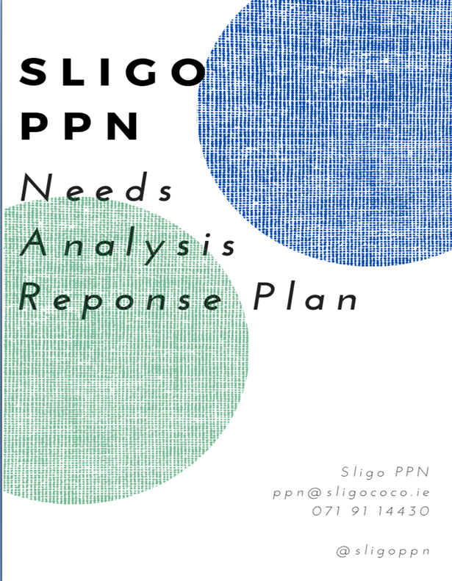
Ongoing Activity Reports
Environment Series
Kids Own Children’s Consultation
Community Representatives training
Health and Wellbeing Vision
Needs Analysis
Notes:
Environment Series
The Environment College of the PPN organised and hosted an online environment series which featured key speakers presenting on current environmental priorities and allowing for questions and answers. The initiative was intended to help PPN community representatives to learn more about key environmental issues that would be relevant at the decision making table.
KidsOwn-Children’s Public Consultation
Sligo PPN has commissioned KidsOwn to develop a brand–new children’s book publication and manifesto which meaningfully reflect the voices of Sligo-based children and their hopes for the future. In light of the current circumstances, we believe it is vital to garner stories from children about their experiences of COVID-19 and how this has impacted on their lives. This will be framed under the broader constructs of health and wellbeing; local environment and sense of community, which connects with the broader objectives of the PPN. Through the manifesto, the children will put forward visions for the future and recommendations, which will contribute to the overall wellbeing vision for the county. This will give the project a strong legacy for local policy and infrastructure and support children to have a role as change-makers and visionaries with the power to have a positive influence on their community.
Community Representatives Training
The year started off with a networking and training session for all PPN representatives to facilitate them to sit comfortably at the decision making table, to understand the PPN and associate structures and to put together recommendation for committee organisers that would facilitate the community voice to be heard. We will be building on this with representatives training from Social Justice Ireland in December and in 2021 there is to be a national roll out of PPN representatives training, commissioned by DRCD, to support reps to fulfil their commitments.
Health and Wellbeing Vision

Slide 7
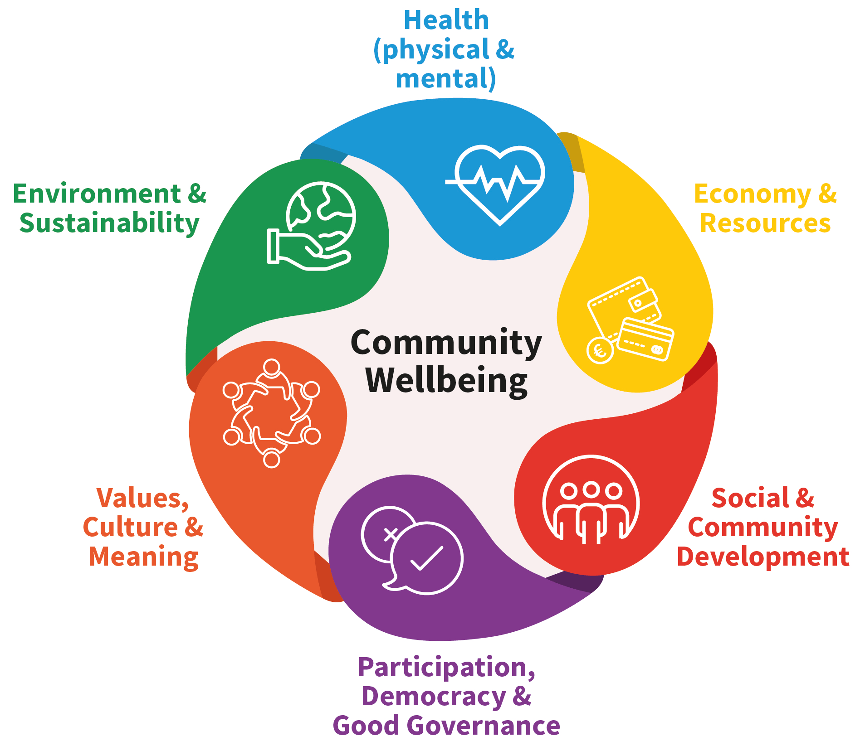
Health and Wellbeing Vision
Each PPN is charged with developing a county wellbeing vision
Sligo PPN have held consultations with around 1000 people
We are now at the stage
of compiling all the feedback
to inform the writing up of
the vision
Notes:
In Sligo we are nearing the end of the consultation phase and beginning to document all the feedback to prepare for putting together our vision. We have used a variety of methods to engage with people from public workshops, online surveys, targeted discussions and by tapping into the expertise of partner organisations. In reviewing the initial responses we identified two key gaps – children and people living with disabilities so we are now working with local organisations and community members to ensure these voices are reflected.
Once the consultations are complete the Secretariat will work with PPN staff and representatives and consultants to create a series of key documents, including the core County Sligo Vision For Wellbeing, the creation of PPN mandates for PPN representatives to take to decision making tables and a detailed index report that can inform future planning in term of the development of wellbeing programming.
At national level, the Department of Rural and Community Development are pulling together a report on the work and findings of these wellbeing initiatives which is to be presented to Office of An Taoiseach.
Additional Notes if needed on the use of the vision
An indication of the range of ways in which the Vision can be
Internally (within the PPN), the Vision can: - inform decision-making; - form the foundation and focus of PPN work, informing Strategic plans for the county; - guide and support PPN representatives to ensure community priorities are reflected at the decision making table - facilitate PPNs’ ability to carry out required monitoring and evaluation of their activities and performance; - provide an opportunity for member groups to engage with their PPN in a positive way.
For the PPN and Member Groups, the Vision can: - Establish and strengthen relationships; - Improve internal capacity for collaborative decision-making, in skills such as facilitation, harvesting and drafting, in development and execution of consultation and other processes; - Encourage greater and more informed participation.
Externally, the Vision can - form the basis of submissions and responses to consultations; - facilitate the PPNs’ ability to carry out required monitoring and evaluation of LA programmes; - be a vehicle to communicate agreed community aspirations to regulators and administrative agencies.

Slide 8
PPN Community Needs Analysis
Priority Issues; Funding, Governance, Environmental support, Undertaking a needs analysis, social media support
Responses
Research and signposting to training
Sharing findings with partner organisations
Sligo PPN Intervention : social media, residents association guide, how to conduct a needs analysis, funding digest, environment support to groups
Notes:
Community Needs Analysis
In September 2020, Sligo PPN undertook a needs analysis to find out how we could best support our member groups over the next 6 months in terms of training and information.
Key Issues to Emerge
Funding, governance, becoming more environmentally friendly, social media and group promotion
It is our aim to try and ensure that something is in place to address all the ideas you prioritised.
We are therefore using the findings of this analysis in a number of ways;
To identify existing training and information programmes that respond to issues highlighted - to highlight and promote these to members for uptake
To share the findings with key local organizations, some of whose core function is to deliver community supports. Organisations include; Sligo Leader Partnership Co, Sligo County Council, Sligo Volunteer Centre and IT Sligo. We will work with these organizations to see if any are in a position to put in place responses.
Where needs are not addressed by any of these approaches, Sligo PPN will look to deliver training options directly by sourcing external support and facilitators.
The needs analysis report at xxxxx contains a list of existing community training opportunities that are currently being delivered. This was something we researched on your behalf and as well as the information being contained in the report, we also continue to promote these training opportunities via our newsletter, email and social media.
The PPN are;
directly delivering a social media training package for groups which is a combination of video tutorials, step by step guides and one-to-one mentor clinics. We have engaged the Digital Marketing Institute to deliver this for us and all content will be tailored to directly respond to issues you raised. It will also be delivered in a way that recognises how time poor community members are, that there isn’t a team of social media experts on hand and that for many of you this is a brand new way of working. Phase 1 which is the tutorials and guides will be done in 2020, phase 2 which is the mentor clinics will be done in 2021 as we wanted to wait until a point in which groups were operational and able to think about engaging in with these kinds of supports.
working with SEN to produce a series of simple ideas and initiatives that every group, regarding of your primary nature, can undertake to become more environmentally friendly. Whatever kind of group you are, from sports to active retirement, there are easy changes and improvements that you can make so that the way you operate on a daily basis has a less negative impact on the environment and SEN will support interested groups to take these steps.
looking to develop a guidebook for Residents Associations with a view to organising facilitators to work with interested RAs in 2021
working with partners in Sligo Volunteer Centre to put together a programme which supports groups to undertake a community needs analysis of their own, which is an important tool for sourcing external funding streams.
once again subscribing to The Wheel Funding Digest on behalf of the Sligo Community. This allows us to remain informed about a whole range of revenue streams and as well as circulating the digest to our members we also extract individual funding rounds and promote them across a range of platforms. The PPN will also continue to work closely with funding bodes such as Sligo County Council and Sligo Leader Partnership Co (SLPCo) to make sure that our members are made aware of all the local funding opportunities open to them. SLPCo also kindly shared with us the great handbook that was produced for their recent funding seminar and this is now available to members on the PPN website.

Slide 9
National Networking
Sligo Representation on
National PPN Advisory Group chaired by Dept of Rural & Community Development
PPN National Communications Strategy
Launch of revised PPN Handbook
National Secretariat
National Resource Worker and Support Worker Meetings
North West Regional Network
Notes:
Sligo PPN were elected to represent the national PPN network on the National Advisory Group hosted by the Department of Community and Rural Development (DRCD) and Chaired by Principle Officer Ciara Bates. This group deals with the oversight of PPN operations and is currently charged with a national structural review of public participation in Ireland to inform how the networks will evolve into the future. It is the first time that the North West has been represented on these national structures and ensures that the needs of the community sector in our area are reflected.
Sligo PPN also have a role on the recently formed DRCD national communications group which is charged with developing an overarching publicity campaign to raise the profile of PPNs across the country. We all recognise that one of the limiting factors to PPN effectiveness has been a lack of awareness from organisations and sectors of the community alike as to what they do and what they can achieve and it is hoped that a national campaign will address this.
A full review of the PPN handbook has taken place and a revised edition was launched last week – you can find a copy on the PPN website. This handbook is intended to act as a guide for all PPN operation. It is divided into sections to be used by various PPN stakeholders.
A National Secretariat network has been established with one Secretariat member nominated from each PPN. DRCD have engaged a facilitator to work with the group and to help them develop. The group have been very active to date.
National Resource Worker meetings of the PPN take place every quarter to allow workers to share ideas, concerns and information. While normally held in Dublin, these have been taking place online and allow for the sharing of good practise, concerns and policy information
In additional to national meetings, North West Regional Meetings are also held every 2 months attended by resource workers and Secretariat representatives to allow for discussion around participation and engagement in the North West.

Slide 10
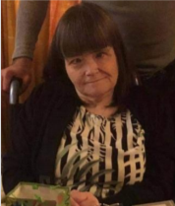
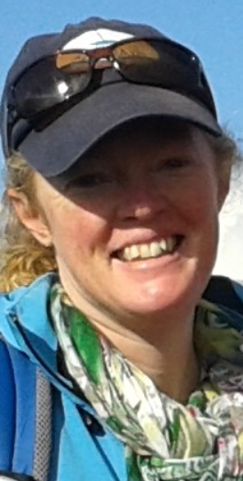
Elections 2020
Sligo Disability Consultative Committee – Clare Heslin
Sligo Leader Partnership Company (Environment Seat) – Auriel Robinson
North West Regional Drug & Alcohol
Task Force (TBC)
Upcoming
Sligo Heritage Forum
Sligo Place Names Committee
Notes:
This year a number of elections have taken place online.
Clare Heslin has been elected to represent the PPN on the re-formed Disability Consultative Committee. Clare was nominated by Cranmore Community Co-Op. The first meeting is yet to be scheduled but we welcome Clare and are sure she will make a positive contribution. We will also be starting up the Disability Interest Group to allow a range of disability groups to work with Clare and feed into the committee.
Auriel Robinson has been elected to take up an environment seat on the board of Sligo Leader Partnership. Auriel was nominated by Sligo Environmental Network. This is the first time that the PPN structure has been used for a nomination to Sligo Leader and we hope it will help to build even stronger connections between the 2 organisations.
We received 3 nominations for the available seats on the North West Regional Drug and Alcohol Task Force – nominations have been sent to the taskforce committee
There are a number of elections to fulfil in 2020 including the Heritage Forum and the Place Names Committee
The PPN now have representation across 14 committees in Sligo and you can read all about these, alongside the representatives working on your behalf and their reports on the PPN website. We will be sending out links to this information.
Just as a point of interest, nationally PPNs have 928 community representatives on 424 boards and committees

Slide 11
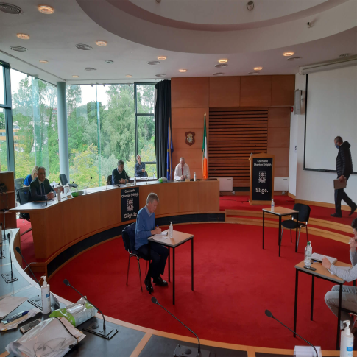
Report from your PPN elected reps on SPC2 – Environment & Infrastructure: Sharon Eastwood & Joan Swift
Attended all SPC 2 meetings.
circulated to PPN groups, agenda items in advance of PPN meetings providing opportunity for input from PPN groups.
discussed specific items eg. cycling provision, integrated space design, road-side planting in line with All Ireland Pollinator Plants, Traffic Flow to reduce carbon emissions, school traffic management.
provided brief summary notes from these SPCs for PPN members (note the formal minutes of SPCs are not available until adopted at subsequent SPC meetings).
followed up specific issues of praise and concern with Council Staff eg. Littering, free mattress / Hazardous recycling days, supports for TidyTowns, Covid mobility and long-term sustainable Infrastructure
attended the series of lectures organised by the PPN for SPC reps.
followed up on the Climate Change interest and success of the Autumn PPN 2019 talk by Prof John Sweeney.
Thank you for electing us as your PPN reps – we hope we continue to proudly represent you and input into the sustainable advancement of County Sligo.
Notes:
Here is just an example of some of the reporting from our SPC representatives.
Full reports from our representatives can be found on the PPN website – our representatives are also very open to hearing from PPN members about key community issues that they would like raising at the decision making table

Slide 12
2021 Plans
PPN Awards
Needs Analysis
Environment Seminar
Community Representatives Training
OneStepCloser – Online Promotion campaign for groups
Secretariat Elections
National Review of PPN Structure
Submission to Review of Strategic Policy Committee Scheme by Dept of Housing
Notes:
We know that for many groups, even getting restarted in 2021 is going to be a challenge. Some groups may never get back together and for those that do the way they operate may have to change. Sligo PPN will be working with the organisation OneStepCloser on a campaign in early 2021 which helps to raise the profile of a selection of groups, encouraging new membership and allowing them to promote their work across the community via online platforms.
Awards 2021
– It was the intention of the PPN to host a county awards programme in September 2019. This was to be done in partnership with ITSligo and was due to take place in the Ariva stadium. Never before has the community sector deserved a celebration more than post 2020. We hope to host an awards night that will give our members the chance to celebrate, the chance to look back on 2020 and all they achieved in keeping the most vulnerable in Sligo safe and to simply reconnect. While the awards themselves will be an added bonus, this process is really about bring the network back together , allowing groups to reconnect and promoting group activities.
Needs Analysis
We will continue with the roll out of interventions to respond to feedback in our needs analysis. There will be a focus on ensuring groups receive adequate funding information and supports, implementing phase 3 of our digital skills programme, environmental support for groups
PPN Environment Seminar
Sligo PPN had scheduled a seminar in partnership with ITSligo and teh SEAI to highlight the options that were available to everyday people in terms of moving towards a more renewable energy focus. This seminar is to be rescheduled in 2021. It will explore the different alternative energy initiatives open to people, what they cost, what options are best for specific needs and how they have a positive environmental impact.
PPN Community Representatives Training
Sligo PPN will be working with DRCD to roll out a comprehensive training programme for all our community representatives in 2021. The nationally developed programme is currently being piloted in the South East with a view to enhance and roll out to the rest of the country in 2021.
Online Promotion Campaign
Sligo PPN will be bringing in online campaign experts to work with a limited number of groups as they look to restart in 2021. Groups will be supported to create promotional videos that tell the story of their activity, raise the profile, help engage new members and which can also be used as groups source new funding streams and supports. These videos will also feature as part of the PPN awards.
Secretariat Elections
April 2021 will see the end of term for a number of our current Secretariat members. The build up to this election process will start in Q1
Nation PPN Structure Review
After 6 years in operation, there will be a national review of the PPN structures which will look at best practise but also issues that are facing PPNs in terms of ensuring effective and meaningful public participation. This will look at the PPNs themselves, but importantly all the supporting structures under which PPNs operate, including current committees at both county and national level.
The Department of Housing have announced they are to do a full review of the SPC schemes and how they operate. At a recent presentation to the PPN network, the Department advised the PPN input would be central to the review, in particular the experiences of PPN representatives at decision making tables.

Slide 13
Thank You
If you have any comments or ideas for projects that you would like the PPN Secretariat to consider in 2021 please email
ppn@sligococo.ie
To view our full Annual Report go to https://www.sligoppn.com/sligo-ppn-annual-report/

