Slide 1
Our Rural Future Rural Development Policy 2021-2025
Gareth Makim,
Rural Strategy Unit
Department of Rural and Community Development

Slide 3
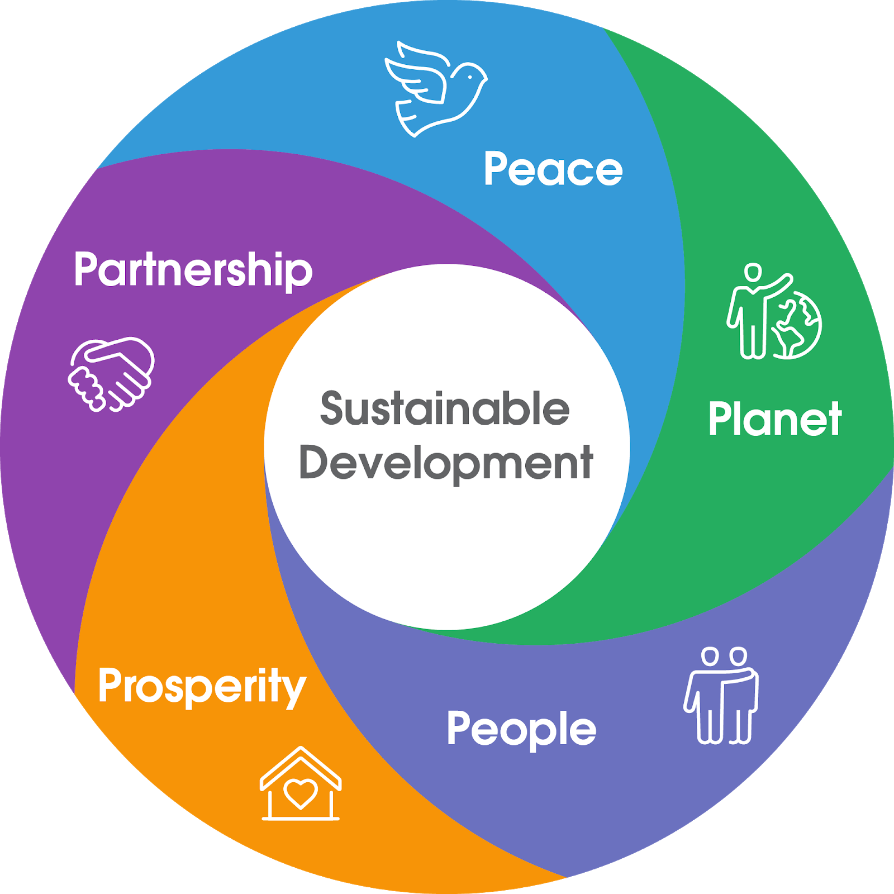
New Rural Development Paradigm

Slide 4
A new approach to rural development
Whole-of-Government policy for rural Ireland for the next five years
Our Rural Future represents an ambitious new approach to rural development in Ireland
Focuses on sustainable economic, social, and environmental development
Emphasises the interdependency of rural and urban areas.
Advocates an integrated, place-based approach to rural development
Aims to maximise the impact, coherence and effectiveness of investment

Slide 5
Consultation Process
Policy development was informed by extensive consultation with rural stakeholders
11 regional consultation with approximately 500 attendees.
2 workshops with young people on the future of rural Ireland
2 public “town hall” events
An online survey, with over 1,700 responses
Focus Groups on the implications of COVID-19 for rural areas
Our Rural Future responds to issues identified by those living/working in rural areas

Slide 6
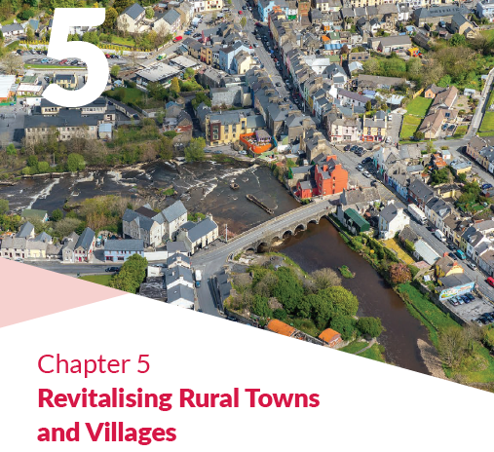
What does the policy focus on?
More than 150 commitments across Government
Optimising opportunities from high speed broadband
Transformational potential of Remote/Connected Working
Supporting Employment and Careers in rural areas
Revitalising rural towns and villages
Enhancing participation, leadership and resilience of rural communities

Slide 7
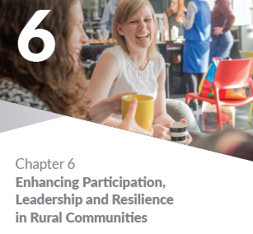
What does the policy focus on (cont’d)?
Enhancing public services
Supporting young people, including through a Rural Youth Assembly
Supporting a Just Transition to a climate neutral society and seizing new opportunities in the Green and Circular Economies
Supporting the sustainability of Agriculture, the Marine and Forestry, attracting more young/female farmers
Ensuring the sustainability and viability of island and coastal communities
Nurturing our culture and heritage.

Slide 8
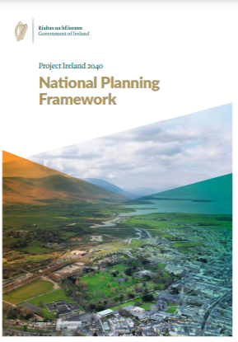
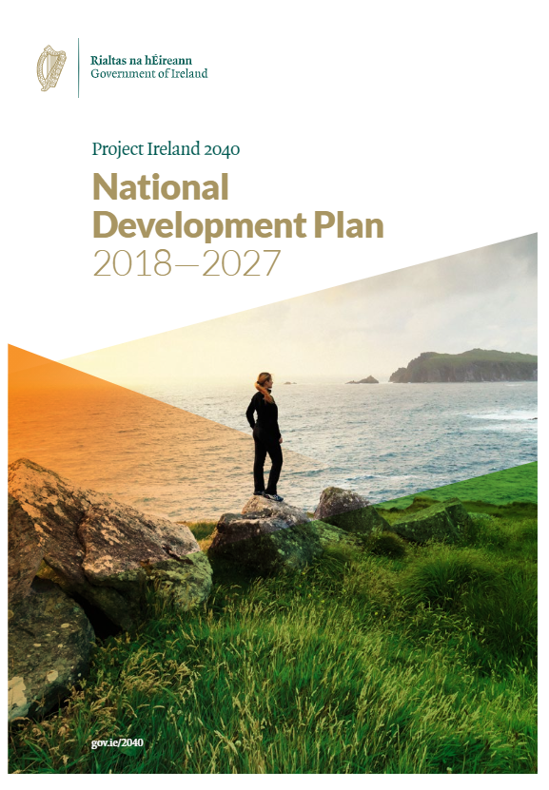
Policy Coherence
Supports delivery of other key Government policies
Directly supports achievement of UN’s Sustainable Development Goals

Slide 9
Key investments
€2.7 billion in the delivery of high-speed broadband to rural areas
€1 billion under the Rural Regeneration and Development Fund to support ambitious projects to regenerate towns and settlements of < 10,000 people
€2 billion Urban RDF will support larger rural towns
Up to €100 million to support a Town Centre First approach, including addressing vacant properties and encouraging more town centre living
€50+ million invested in walking and cycling infrastructure
Significant investment in Remote Working infrastructure / National Network

Slide 10
Other New Measures
Support rural communities to develop Master Plans to meet the long-term needs of their area
Pilot new rural transport initiatives
Pilot scheme to support use of rural pubs as community spaces / local hubs
Prioritise regional sites for new Government or public agencies
Develop and implement key Strategic Plans across a range of sectors:
Outdoor Recreation | Agri-food | Islands development
Dark Skies | National Heritage | Apprenticeships

Slide 11
Delivery
The Policy will be implemented over the next five years
Annual Work Programmes and Progress Reports
2021 Programme – 128 of 152 commitments will be delivered or substantially advanced.
First Progress Report – end 2021
Ongoing engagement – a living document.
New commitments

Slide 12
What difference will it make?
More people living and working in rural Ireland
Rural towns as vibrant hubs for commercial and social activity
Reduced regional income disparities
Improved access to public services, such as transport links
Rural Ireland benefits from the transition to a more sustainable future.
Rural communities, and especially young people, having an active role in shaping their future

Slide 13
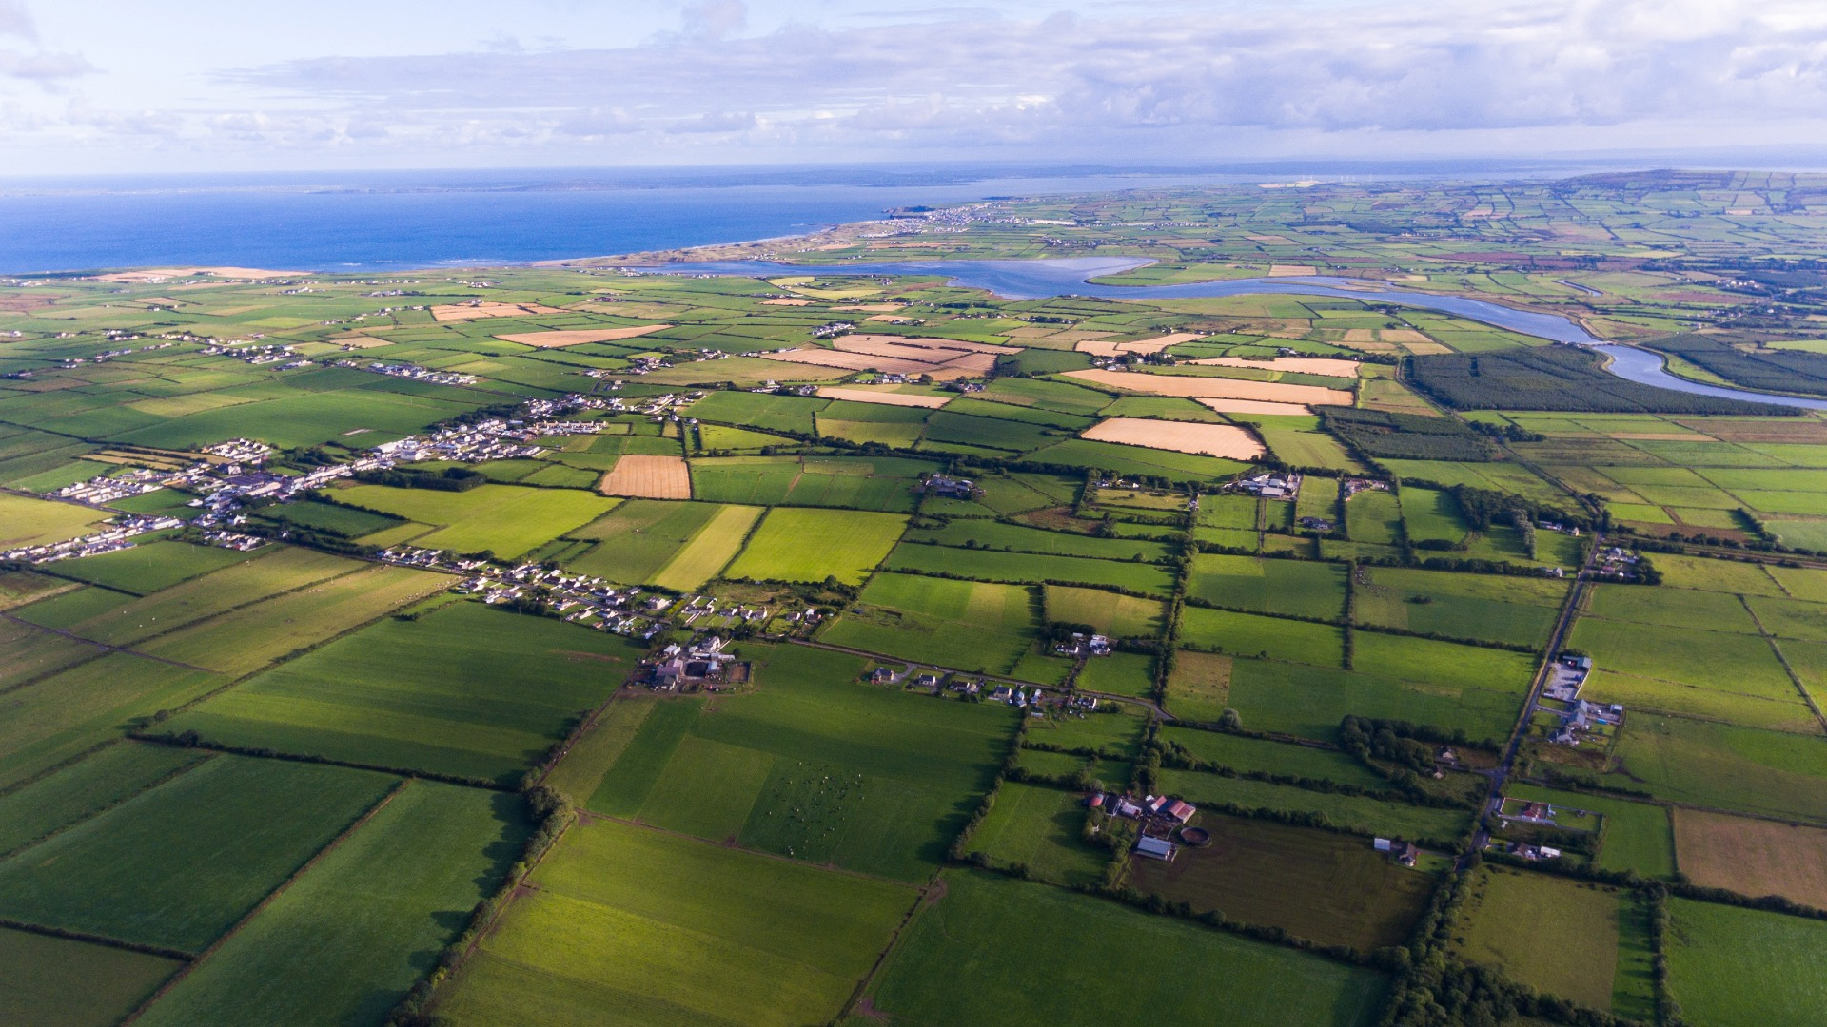
Thank you
Rural.Strategy@drcd.gov.ie

