Slide 1
Session 1:The Role of the PPN and the Secretariat
Susanne Rogers
Research and Policy Analyst
Social Justice Ireland

Slide 2
So – what’s going to be covered?
Section 1: Why the PPN?
Section 2: Stakeholder Roles and Responsibilities

Slide 3
Section 1: About the Public Participation Networks

Slide 4
Development of the PPN
UN, OECD and EU recommendations
Address Democratic Deficit
Need to encourage more active citizenship and participation
Produce better decision making
Ireland
White paper on voluntary activity (2000)
Task Force on Active Citizenship (2007)
Working Group on Citizen Engagement (2013)
Local Government Reform Act 2014

Slide 5
What is the PPN?
Focused on PUBLIC PARTICIPATION
Statutory entity – established by the Local Government Reform Act, 2014
Giving a voice to community groups on Local Authority committees and boards
Main way for Local Authorities to engage with communities
Provides a pathway for communities to have a real voice in decision-making committees and boards at Local Authority level.
Providing a vision for change through social policy, participation and representation
It’s about coming together as a collective to shape your community

Slide 6
What is the PPN?
“The primary purpose of the PPN is to enable the PPN member groups to input into and have their voices heard within the formal decision-making structures of the local authority. The PPN is now the main way that local authorities connect with groups active in their area.”
PPN Handbook

Slide 7
Functions of the PPN
Facilitates the participation and representation of communities in a fair, equitable and transparent manner through the environmental, social inclusion, and community & voluntary sectors on decision making bodies
Strengthens the capacity of communities and of the environmental, social inclusion, and community & voluntary groups to contribute positively to the community in which they reside/participate
Provides information relevant to the environmental, social inclusion, and community & voluntary sector and acts as a hub around which information is distributed and received.
Participation
Capacity Building
Information

Slide 8
Role of the PPN
to encourage and enable public participation in local decision making and planning of services.
to identify issues of collective concern and work to influence policy locally.
to actively support inclusion of socially excluded groups, communities experiencing high levels of poverty, communities experiencing discrimination, including Travellers to enable them to participate at local and county level and to clearly demonstrate same.

Slide 9
Role of the PPN
facilitate selection of representatives onto county decision making bodies.
support a process that will feed the broad range of ideas, experience, suggestions and proposals of the Network into policies and plans being developed by agencies and decision makers in areas that are of interest and relevant to the Network
work to develop the Environmental, Social Inclusion and Community and Voluntary sectors so that the work of the sectors is clearly recognised and acknowledged and the sectors have a strong collective voice within the County.

Slide 10
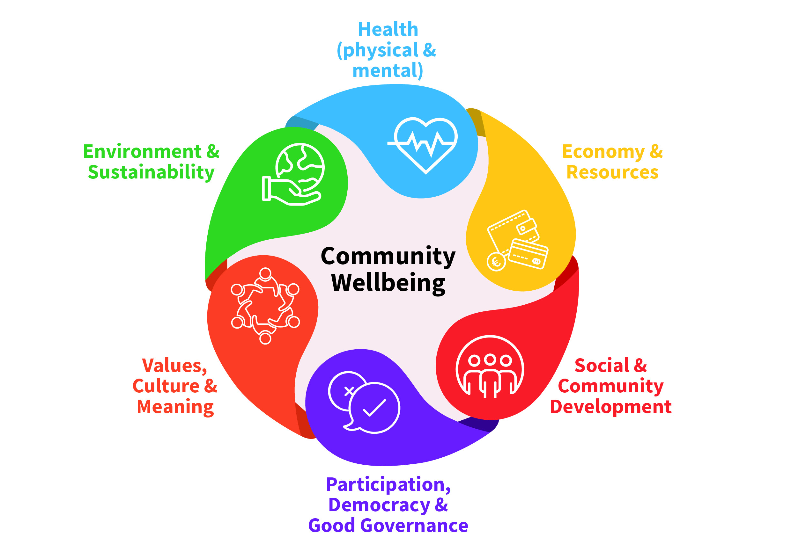
Role of the PPN
support the individual members / organisations of the PPN so that:
they develop their capacity and do their work more effectively.
they participate effectively in PPN activities.
they are included and have their voices and concerns are heard.
to facilitate opportunities for networking, communication and information sharing between groups and between these groups and the LA.
to contribute to the development of a Vision for Community Wellbeing for this and future generations.

Slide 11
Principles and Values of the PPN
Inclusive
Accountable
Participatory
PPN
Transparent
Independent
Values Diversity

Slide 12
Purpose of the PPN
Delivering Deliberative Democracy
Delivering on the Sustainable Development Goals
EU Conventions and Treaties
Delivering Shared Responsibilities
Irish Commitments

Slide 16
Who can join the PPN?
All “not for profit” groups active in the area
Select a College based on primary activity
Social Inclusion
Environmental
General Community and Voluntary
Inclusive of minority or traditionally hard to reach groups
Not political parties

Slide 17
The Structure
Flat structure
Rotating Facilitator
Plenary
Municipal District Plenaries
3 Colleges
Community and Voluntary
Social Inclusion
Environmental
Linkage Groups

Slide 18
Section 2: Stakeholder Roles and Responsibilities

Slide 19
The Stakeholders
Linkage Groups
Reps
Plenary (the Members)
National Advisory Group
Secretariat
PPN
Boards and Committees
Local Authority
PPN Workers
Department of Rural and Community Development

Slide 20
Role, Responsibilities and Rights
Linkage Group
Rep
Committee

Slide 21
Role of the Representative
Representatives play a pivotal role in ensuring that the PPN achieves it overall purpose. The role of a PPN representatives is to:
Attend and participate fully in meetings of the Linkage Group and committee, including any subgroups to which they may be appointed
Bring forward the issues of the Linkage group to the committee for their consideration, including putting items on the agenda. They are not there just to represent their own group or agenda.
Work collaboratively with the Linkage Group to identify issues, research, policy proposals etc.
Communicate regularly (at least as frequently as meetings are held) with the Linkage Group on matters such as
Dates of committee meetings
Agendas for committee meetings
Reports and Feedback from committee meetings
Items which require their input or are of interest
Ensure adequate minutes are taken at Linkage Group meetings and are shared with PPN.
Network and work strategically with other committee members for the benefit of the Linkage group and of PPN, including being able to compromise while retaining the core objective.

Slide 22
Responsibilities
Responsibilities of the Representative are to
Organise Linkage Group Meetings and effective two way communications with Linkage Group members [with the support of the development officer].
Be able to use basic electronic communications effectively (i.e. email and internet browsing)
Prepare thoroughly for, attend and participate actively in Linkage Group and Committee meetings solely on behalf of PPN, leaving any personal, business or political interests outside.
Work openly and collaboratively with all Linkage Group members to identify issues, research, policy proposals etc., respecting the diversity of views expressed.
Put forward opinions / views of Linkage Group to Committee and feedback the work of the committee clearly (non jargon) to the Linkage Group
Attend relevant training or networking events organised by PPN or the Committee.
Be open and honest in dealings with all stakeholders
Build positive relationships with other committee members for the benefit of the PPN.
Portray PPN and the Linkage Group in a positive and constructive way.

Slide 23
Rights
Rights of the Representative are to
Have active engagement from the Linkage Group, including timely responses to issues.
Be heard and respected at both the Linkage Group and Committee, with an appreciation that they are a volunteer.
Be supported by both Linkage Group and Committee members, understanding that the PPN is a new and evolving process.
Have access to an agreed outcome statement from meetings which can be circulated immediately afterwards.
Receive relevant training to enable them to participate effectively on the Committee
Receive expenses for attending committee meetings.
Have at least some meetings held at a time and location which facilitates them.

Slide 24
Rights
Rights of the Representative are to (continued)
Receive an induction pack for the Committee / Board on taking up their appointment, to include:
Terms of reference
Standing orders /procedures
Meeting schedules, locations and times
Contact details for all Committees / Board members
Access to technical support where required
Receive timely notice of Committee / Board meetings (at least two weeks in advance, and more if possible) including:
Dates and venues
Agenda
Documents to be read
Have meetings conducted in a way that facilitates participation, open discussion and transparent decision making.

Slide 25
Have a think…
In fulfilling my role and responsibilities as a Representative:
The biggest challenge I have / had as a representative is…
The thing that has been most useful in my role is / has been…
This Photo by Unknown Author is licensed under CC BY-SA-NC

Slide 26
Secretariat
Administrative arm of the PPN – takes instructions from the Plenary
Membership reflects Colleges and Geographic Structure
Wide and varied role, although some functions may be delegated
The Secretariat

Slide 27
Secretariat - Role
Help put operational decisions of the Plenary in place.
Make sure that the PPN is working properly in between Plenaries on behalf of the Member Groups.
Organise or help to organise the PPN activities on behalf of the Member Groups.
Communicate regularly with all PPN Members and share information about all PPN activities as widely as possible.
Keep correct, up to date, records of PPN business, including minutes of meetings and make sure agendas are circulated in good time.
Be a point of contact for the PPN for the Local Authority, Department of Rural and Community Development, other PPNs, the National Advisory Group and other stakeholders of the PPN.
Deal with all correspondence on behalf of PPN, by sending out copies and writing responses.
Facilitate and enable the PPN Workers in their day to day activities to deliver PPN objectives of the PPN.

Slide 28
Secretariat
Rotating Chair / Facilitator
Training for the Role
Maintain Flat Structure
Secretariat Meetings
The Secretariat

Slide 29
Secretariat - Functions
The development and implementation of the Strategic Plan
Facilitating and enabling the PPN Workers in their day to day activities to deliver PPN objectives.
Making sure that the Flat Structure is kept in place
Promoting the PPN and Membership
Managing the membership database of the PPN (subject to GDPR regulations)
Overseeing elections for PPN Representatives
Being accountable to the Plenary and carrying out their instructions

Slide 30
PPN Workers
The Role of the PPN Workers is to “support the Secretariat and the Plenary and to carry out duties and tasks on behalf of the PPN following the PPN Workplan.”
PPN Workers

Slide 31
PPN Workers - Functions
Development of the Strategic Plan
Promotion of the PPN
The capacity building, networking and information provision needs of PPN Member Groups
Support PPN Representatives on Boards and Committees
Support PPN Secretariat
Support PPN to liaise with the Local Authority to further the PPN agenda
Engage in PPN work at a national level

Slide 32
PPN Workers
Election to Government Office
National Network
PPN Workers

Slide 33
Elected Councillors
Adopting the Annual Budget
Adopting the LECP
CEO oversight
Decision-making on Economic Development
District Level Functions
Oversight of Community Development Programmes

Slide 34
Elected Councillors
Meet Monthly (public can attend)
Adopt Corporate Plan
Disposal of Land
Making Co Development Plan / variations
Adopting Annual Budget / level of property tax / rates
Bye laws
Nominating / ratifying people re committees

Slide 35
Council Staff
CEO
Directors of Services (Community and Economic Development etc)
Executive functions
Processing planning applications
Allocating houses
Making small grants
Everything that is not reserved

Slide 36
Local Government in Municipal Districts
Subset of Councillors
Meet independently and feed into main council
Locally based funding – Tidy Towns, Graveyards, Local Roads etc.
Locally based services
Headed by
Engineer
Administrator

Slide 37
What are Linkage Groups?
PPN Member Groups interested in a particular area or areas
“Linked” to a Board or Committee
Elect Representatives
Feed into the Representatives’ Mandate
Get feedback from Representatives on Board / Committee Meetings
HAVE A REALLY IMPORTANT ROLE!!!

Slide 38
Linked to a Board or Committee
Local Community Development Committee
Local Community Development Committee
Local Community Development Committee
Local Community Development Committee
Local Community Development Committee
North West Fisheries Local Action Group
North West Fisheries Local Action Group
North West Fisheries Local Action Group
North West Fisheries Local Action Group
North West Fisheries Local Action Group
Independent Evaluation Committee
Independent Evaluation Committee
Independent Evaluation Committee
Independent Evaluation Committee
Independent Evaluation Committee
Independent Evaluation Committee
Environment and Infrastructure
Climate Change
Disability Consultative Committee
Disability Consultative Committee
Disability Consultative Committee
Disability Consultative Committee
Public Arts Steering Committee
Public Arts Steering Committee
Public Arts Steering Committee
Public Arts Steering Committee
Sligo PPN
Planning,Community, Economic Development, Arts and Culture
Housing and Corporate
Sligo Sport & Recreation Partnership
Sligo Sport & Recreation Partnership
Sligo Sport & Recreation Partnership
Sligo Sport & Recreation Partnership
Place Names Committee
Place Names Committee
Place Names Committee
Place Names Committee
Joint Policing Committee
Joint Policing Committee
Joint Policing Committee
Joint Policing Committee
Joint Policing Committee
Heritage Forum
Heritage Forum
Heritage Forum
Heritage Forum
Heritage Forum

Slide 39
Structure of Linkage Groups
Equal Status
Rotating Facilitator
Sub-Groups

Slide 40
Role of Linkage Group Facilitator
Administrative Function
Rotates Annually
Remember! Equal Status!

Slide 41
Reporting on behalf of the PPN / Linkage Group (feeding in)
Why is it important?
Role of the Representative (you speak for the Linkage Group / PPN, not yourself or your own organisation / group)
Builds trust with the Linkage Group
Informs policy and processes
Enables networking and sharing

Slide 42
Reporting on behalf of the PPN / Linkage Group (feeding in)
What is the best way to do it?
Engage with Linkage Group members – use technology if it helps!
Make a note of key points of action related to your Committee / a specific agenda
Feed those notes back to the Linkage Group to ensure agreement and keep on central system
If possible, have some illustrative case studies to get your point across
Provide key agenda items to the Committee Chair / Facilitator in advance of the meeting
If you get knocked back / put off – try again (and keep trying!)

Slide 43
Reporting back to the PPN / Linkage Group
Why is this important?
Keeps the Linkage Group informed, who can then inform their own members
Builds capacity throughout the Linkage Group on the procedures and thought processes at Committee meetings
Builds trust with Linkage Group members
Supports the Committee structures

Slide 44
Reporting back to the PPN / Linkage Group
What’s the best way to do it?
PPN Reporting Template
Specific Reporting Template?
Consider what works best for the members of your Linkage Groups
Develop an agreed process together
Store centrally
What happens if there’s no engagement?
Follow best practice anyway
circulate agenda items / ideas to everyone on the group
provide feedback
highlight where issues have been addressed

Slide 45
Get Feedback
Representatives are required to provide feedback, if you don’t have it – ask for it!
Has your issue been considered?
If yes – what was the outcome?
If no – why not?
What’s next? – Remember to manage expectations

Slide 46
The Representative Charter
Each PPN will have a Representative Charter. It sets out the relationship between the Rep and the PPN.
The PPN Handbook recommends that “before a potential Representative decides that they want to be nominated, they should read their PPN’s Representative Charter in full and ask their PPN Resource Worker if they have any questions or need anything clarified.’
A sample Charter is also available in Appendix 3 of the Handbook.

Slide 47
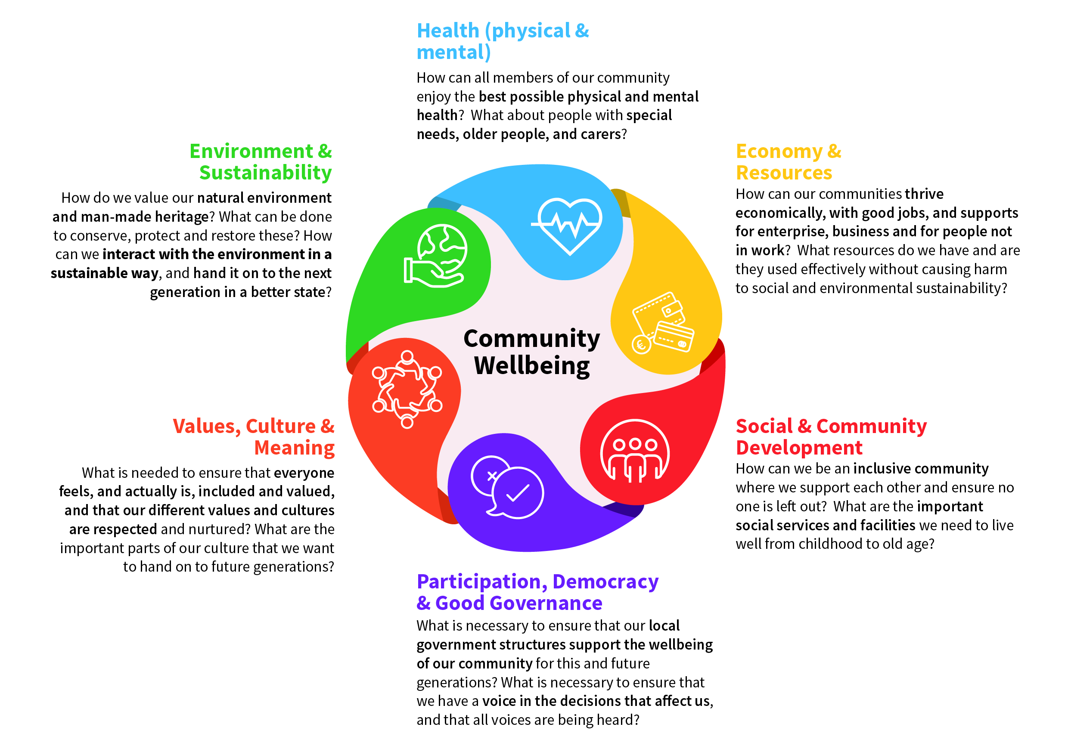
The Reps Mandate – Vision for Community Wellbeing

Slide 48
Feed into the Representatives’ Mandate
Use your experience and expertise
Inform discussion
Bring forward issues of concern

Slide 49
Recap
Representation on Committees give a voice to communities
It’s important to understand shared areas of interest / concern – the more voices across more Committees, the greater the possibility of change
Being a Representative is a key role for the PPN – it comes with Responsibilities and Rights
Engagement is crucial to get the job done
The Vision for Community Wellbeing provides a mandate to support you in your role

