Slide 1
Using the PPN to engage with decision-making structures
Colette Bennett
Economic and Social Analyst
Social Justice Ireland

Slide 2
What are we going to cover?
Committees and Boards – Policy Issues
Membership Review
Identifying Policy Areas
PPNs and National Policies
Identifying Policy Instruments
Making the National, Local

Slide 3
Committees and Boards – What are the Issues?

Slide 4
Committees and Boards - Issues
Organisational | Policy | Policy
Ambition and Attitude | Volunteering | Enterprise / Local Economy
Collaborative Working and Planning | Community Supports | Workers
Governance and Administration | Inclusion and Awareness | Health Services
Local Authority | Heritage | Mental Health Supports
 | Local Authority | Wellbeing
 | Community Spaces and Facilities | Nature and Resources
 | Housing | Waste
 | Infrastructure | Energy
 | Safety | Scenery and Access to Recreation
 | Transport

Slide 5
Membership Review
511 Member Organisations
457 Community
13 Environment
41 Social Inclusion
What are THEIR issues of interest?

Slide 6
Example: Social Inclusion (41 members, 15 issues)
Older People
Women’s Issues
Health and Disability
Sports and Recreation
Participation and Democracy
Housing
Diversity and Integration
Domestic Abuse
Religion
Education
Addiction (could also fall under Health and Disability)
Family Supports
Poverty
Community Supports
Human Rights

Slide 7
Committees and Members (Social Inclusion)
Committees | Members (Social Inclusion
Volunteering Community Supports Inclusion and Awareness Heritage Local Authority Community Spaces and Facilities Housing Infrastructure Safety Transport Enterprise / Local Economy Workers Health Services and Mental Health Supports Wellbeing Nature and Resources Waste Energy Scenery and Access to Recreation | Older People Women’s Issues Health and Disability Sports and Recreation Participation and Democracy Housing Diversity and Integration Domestic Abuse Religion Education Addiction (could also fall under Health and Disability) Family Supports Poverty Community Supports Human Rights

Slide 8
The PPN and National Policy
“Similarly, our Public Participation Networks (PPNs) are driven by volunteers. Without the commitment and engagement of the volunteers in the 31 PPNs across the country, our local decision making structures would not be influenced by the voices and input of the PPN member groups, of which there are currently 17,721.”
“…Public Participation Networks (PPNs), which give volunteer-led groups a direct voice in local government. PPNs also enable groups to connect with others in their locality and provide capacity-building opportunities such as training and workshops.”
National Volunteering Strategy, 2021-2025

Slide 9
The PPN and National Policy
“In addition, the new Public Participation Networks (PPNs) provide the direct link between communities and Local Community Development Committees, facilitating and supporting engagement of communities in decision-making at local level.”
“Their main role is to facilitate participation and representation of communities in a fair, equitable and transparent manner, through the environmental, social inclusion, and community and voluntary sectors, on decision-making bodies including LCDCs and Strategic Policy Committees.”
Sustainable, Inclusive and Empowered Communities, A five-year strategy to support the community and voluntary sector in Ireland, 2019-2024

Slide 10
The PPN and National Policy
Sustainable, Inclusive and Empowered Communities, A five-year strategy to support the community and voluntary sector in Ireland, 2019-2024

Slide 11
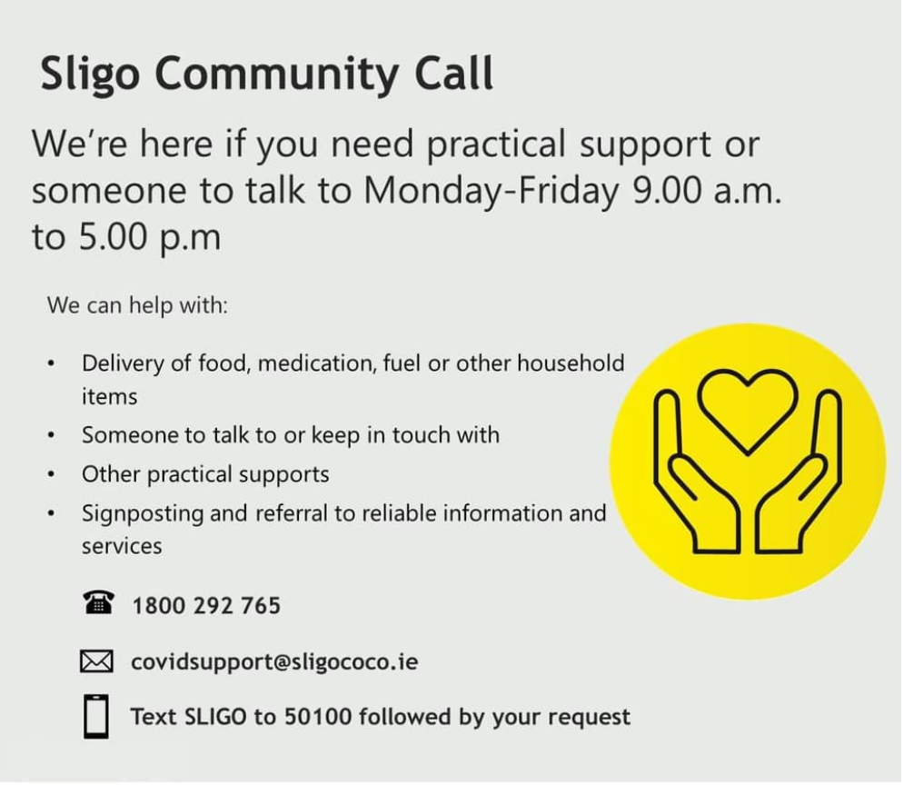
The PPN and National Policy

Slide 12
The PPN and National Policy

Slide 13
The PPN and National Policy
“Identify core themes from CAP and other policy priority areas to be examined in the NDCA activities including Just Transition, energy, waste, built environment, transport and agriculture.”
“Complete PPN structural review, including a focus on ensuring PPNs are fit for purpose for climate action.”
“Continued support for the development of PPN Community Wellbeing Statements via structured consultation process with PPN members.”
Climate Action Plan 2021, Annex of Actions

Slide 14
The PPN and National Policy
“Organise and host Broad Online Conversations.”
“Facilitate consultation with communities on climate policy through Public Participation Networks.”
Climate Action Plan 2021, Annex of Actions

Slide 15
The PPN and National Policy
“Ireland’s National Implementation Plan for the SDGs identifies the crucial role that Local Authorities have to play in translating the SDGs into practical action at a local level. Throughout the lifetime of Saolta, Development Perspectives will be working to support Public Participation Networks (PPNs) across Ireland in integrating the SDGs into County Development Plans. Development Perspectives will also be supporting PPNs in mapping their goals to strategic SDG actions.”
Development Perspectives Saolta Programme

Slide 16
What are the Issues from National Policies?
Participation and Democracy
Community Support
Climate Action
Just Transition
Sustainable Development Goals

Slide 17
Committees, Members (Social Inclusion) and National Policies
Committees (19) | Members (Social Inclusion)(15) | National Policies (5)
Volunteering Community Supports Inclusion and Awareness Heritage Local Authority Community Spaces and Facilities Housing Infrastructure Safety Transport Enterprise / Local Economy Workers Health Services and Mental Health Supports Wellbeing Nature and Resources Waste Energy Scenery and Access to Recreation | Older People Women’s Issues Health and Disability Sports and Recreation Participation and Democracy Housing Diversity and Integration Domestic Abuse Religion Education Addiction (could also fall under Health and Disability) Family Supports Poverty Community Supports Human Rights | Participation and Democracy Community Support Climate Action Just Transition Sustainable Development Goals

Slide 18
What you want is to be able to develop one policy issues list…
…then link it to both Member Groups and Committees.
Doing that gives you networks / groups!

Slide 19
Committees, Members (Social Inclusion) and National Policies
Committees (19) | Members (Social Inclusion)(15) | National Policies (5)
Volunteering Community Supports Inclusion and Awareness Heritage Local Authority Community Spaces and Facilities Housing Infrastructure Safety Transport Enterprise / Local Economy Workers Health Services and Mental Health Supports Wellbeing Nature and Resources Waste Energy Scenery and Access to Recreation | Older People Women’s Issues Health and Disability Sports and Recreation Participation and Democracy Housing Diversity and Integration Domestic Abuse Religion Education Addiction (could also fall under Health and Disability) Family Supports Poverty Community Supports Human Rights | Participation and Democracy Community Support Climate Action Just Transition Sustainable Development Goals

Slide 20
Policy Instruments
Example

Slide 21
Policy Instruments – E.G. Housing
National | Local
Housing for All Strategy 2021 | Summary of Social Housing Waiting Lists
Housing Options for Older People Policy Statement 2019 | Council Budget for Housing
Housing and Disability Strategy 2022 | Social Housing Targets
SDGs – Sustainable Communities | LECP

Slide 22
Making the National, Local
Things to consider:
Are you happy with the local plan / policy?
Is there an area you’d like to change / know more about?
What does the national plan / policy say – does it differ / help?

Slide 23
Thank You

