Slide 1
Session 5- Local Authorities and the PPN
Susanne Rogers
Research and Policy Analyst
Social Justice Ireland

Slide 2
So – what’s going to be covered?
Section 1: Making Connections
Section 2: Working together

Slide 3
Section 1: Making Connections

Slide 4
Local Authority Structures
31 Local Authorities
26 County Councils
3 City Councils
2 City and County Councils
949 Councillors
3 Regional Assemblies
Eastern & Midlands Regional Assembly
Northern & Western Regional Assembly
Southern Regional Assembly
Committees and Boards

Slide 5
The Local Authorities
Services provided
Housing
Road, Transport & Safety
Recreation and Amenity
Planning
Library Services
Water
Environmental Protection
Economic Development
Fire Service
Register of Electors
Decision-makers
Elected Council on policy. Can be made at full (plenary) level or Municipal District Level
Chief Executive and senior management team make the operational decisions

Slide 6
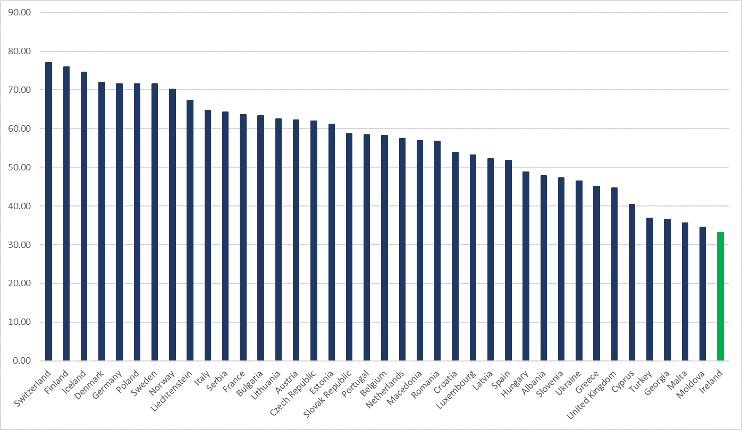
Self Rule Index – Local Autonomy

Slide 7
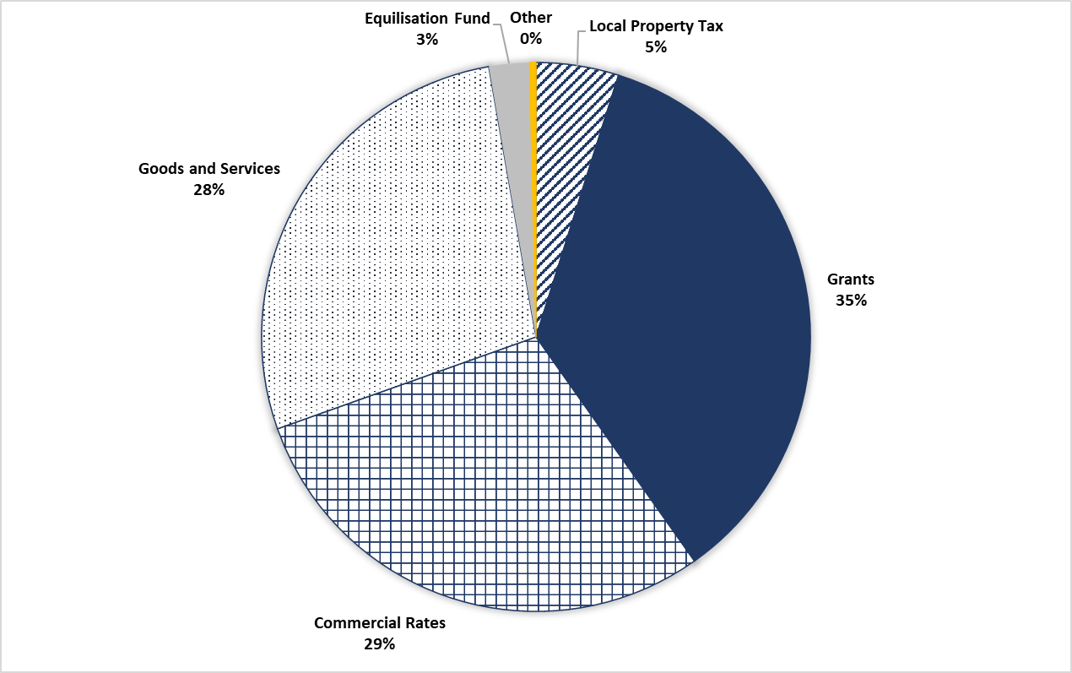
Local Authority Income

Slide 8
Local Committees
Established by the Local Authority or other State body
Bring a “community voice” to local government decision-making
Ultimate policy decisions taken by whole Council

Slide 9
Regional Assemblies
Came into being following the Local Government Reform Act 2014
8 Regional Authorities became 3 Regional Assemblies
Functions
Implement the appropriate Regional Planning Guidelines operational within its geographical area.
Prepare, adopt and implement the Regional Spatial and Economic Strategies.
Ensure consistency with RPG/RESES in relation to the Local Economic and Community Plans of the constituent Local Authorities.
Participate on EU operational programme monitoring committees.
Identify, participate and co-ordinate certain EU projects.
Support the national delegation to the Committee of the regions.
Support the work of the National Oversight and Audit Commission.

Slide 10
What is the PPN?
“The primary purpose of the PPN is to enable the PPN member groups to input into and have their voices heard within the formal decision-making structures of the local authority. The PPN is now the main way that local authorities connect with groups active in their area.”
PPN Handbook

Slide 11
What is the PPN?
Focused on PUBLIC PARTICIPATION
Statutory entity – established by the Local Government Reform Act, 2014
Giving a voice to community groups on Local Authority committees and boards
Main way for Local Authorities to engage with communities
Provides a pathway for communities to have a real voice in decision-making committees and boards at Local Authority level.
Providing a vision for change through social policy, participation and representation
It’s about coming together as a collective to shape your community

Slide 12
Functions of the PPN
Facilitates the participation and representation of communities in a fair, equitable and transparent manner through the environmental, social inclusion, and community & voluntary sectors on decision making bodies
Strengthens the capacity of communities and of the environmental, social inclusion, and community & voluntary groups to contribute positively to the community in which they reside/participate
Provides information relevant to the environmental, social inclusion, and community & voluntary sector and acts as a hub around which information is distributed and received.
Participation
Capacity Building
Information

Slide 13
Purpose of the PPN
Build community capacity – broadening understanding and participation
Bring community concerns to decision making arena
Linkage groups
Electing representatives
Participating in consultations etc.
Sharing information
Building relationships between communities and agencies
© Social Justice Ireland
W: www.socialjustice.ie T: @SocialJusticeI F: fb.me/SocialJusticeI
Notes:
<number>

Slide 14
Role of the PPN
to encourage and enable public participation in local decision making and planning of services.
to identify issues of collective concern and work to influence policy locally.
to actively support inclusion of socially excluded groups, communities experiencing high levels of poverty, communities experiencing discrimination, including Travellers to enable them to participate at local and county level and to clearly demonstrate same.

Slide 15
Public Participation
...could rapidly improve our quality of life. It can contribute to creating more active citizens, help manage complex problems in public service design and delivery, help build the new relationships and shifts of power and resources required for 21st Century governance and develop individual’s skills, confidence, ambition and vision. (Mulgan,2005)
Public service workers are being exposed to new experiences and encounters that have the capacity to change their orientations to what they do….does this represent a fundamental change in governance?Will it result in political renewal? (Barnes, Newman, Sullivan, 2007)

Slide 16
Public Participation
Does it empower citizens?
Does it lead to public policy change?
Does it enhance democracy?
Does it change discourse both/either public or private?
Are institutional norms maintained?
Is it impossible to represent all views?
Are participants changed by their engagement?
Do identities and interests shift?
Does the conduct of officials/volunteers change?
Does the process of delivering public services change?

Slide 17
Purpose of the PPN – for Member Groups
© Social Justice Ireland
W: www.socialjustice.ie T: @SocialJusticeI F: fb.me/SocialJusticeI
Notes:
<number>

Slide 18
Benefits of the PPN – for Member Groups
Have your voice heard in policy
Deliberative Democracy
Membership Supports
Information
© Social Justice Ireland
W: www.socialjustice.ie T: @SocialJusticeI F: fb.me/SocialJusticeI
Notes:
<number>

Slide 19
Purpose of the PPN – for Local Authorities
© Social Justice Ireland
W: www.socialjustice.ie T: @SocialJusticeI F: fb.me/SocialJusticeI
Notes:
<number>

Slide 20
Benefits of the PPN – for Local Authorities
Voice of the Community
Deliberative Democracy
Better decision-making
More sustainable policies
© Social Justice Ireland
W: www.socialjustice.ie T: @SocialJusticeI F: fb.me/SocialJusticeI
Notes:
<number>

Slide 21
So….a more active and engaged citizenry …..met by a more responsive and effective state (Barnes,2007) Partners? Expertise acknowledged? Where does power lie?

Slide 22
Section 2: Working Together. How PPNs can support Local Authorities to shape policy?

Slide 23
Looking Back: Strategic Aspects of Participation
Start with the agenda / issue
Know your mandate
Do your research
Network
Engage

Slide 24
Delivering Deliberative Democracy
Delivering on the Sustainable Development Goals
EU Conventions and Treaties
Delivering Shared Responsibility
Irish Commitments
© Social Justice Ireland
W: www.socialjustice.ie T: @SocialJusticeI F: fb.me/SocialJusticeI
Notes:
<number>

Slide 25
Corporate Policy Group
Established under section 133(10) of the Local Government Act, 2001 and developed as amended by section 48 of the Local Government Reform Act 2014 with Circular LG 07/2014
Sets the agenda and policy options positions for whole council
May ask SPCs to look at certain issues
Key role in preparing budget
Monitor overall performance
Oversee reserved functions
Membership consists of
Chair of Council
Chairs of SPCs
MD Chairs (if not already SPC chairs)
Supported by CEO

Slide 26
Strategic Policy Committees
Established under section 54(2) of the Local Government Act, 2001 and developed as amended by section 48 of the Local Government Reform Act 2014 with Circular LG 07/2014
Advise and assist Council with formulation, development and monitoring of policy
Membership
15 members
10 elected members
5 sectoral interests, including the PPN
Led by Director of Services
Adopt a multiannual work programme

Slide 27
Strategic Policy Committees
Council remains the decision-making body
Functions extend from those aligned directly with Local Authority functions and other non-statutory fields, such as urban or rural renewal
Training and supports for SPC members should be included in the SPC scheme of each Local Authority

Slide 28
Strategic Policy Committees - Procedures
The SPC chair and relevant Director of Service should meet well in advance of an SPC meeting to clarify the agenda for the forthcoming meeting and to agree on 12 objectives and what they would like as expected outcomes.
A calendar of SPC meetings should be agreed at the start of each year. SPCs should normally be held about 4 times yearly at suitable times for all SPC members.
SPC meetings should be conducted in a much less rigid and formal way than full council meetings in order to create an informal and collaborative atmosphere that would allow honest views and opinions on policy issues.

Slide 29
Strategic Policy Committees - Procedures
The local authority should provide a key contact person (other than the Director of Service) for all SPC members and particularly for sectoral representatives to deal with SPC matters.
Local authorities should also consider the most appropriate locations for holding SPC meetings perhaps making greater use of community halls and centres.
Local authorities should ensure that documentation concerning SPC meetings is sent well in advance of the meetings, if possible four weeks in advance. The agenda and minutes of SPC meetings should also be circulated well in advance to all SPC members.
Â

Slide 30
Local Community Development Committee (LCDC)
Replaced the County Development Board​
Prepares, implements and monitors the community elements of the six-year Local Economic and Community Plans​
Responsible for National Funding at Local Level​:
SICAP (Social Inclusion)​
LEADER (Rural Development)​
Other ​
Improve co-ordination of programmes and reduce duplication​

Slide 31
Local Community Development Committee (LCDC)
Made up of
members of the local authority
local authority staff
people from public bodies who provide funding to the area
people from the local community interests
people from the local community
people from publicly funded/supported local development groups

Slide 32
Examples of Strategic Policy Committees

Slide 33
Strategic Policy Committees - Examples
Planning, Environment, Climate & Biodiversity Action, Energy and Agriculture
Planning, Environment, Climate & Biodiversity Action, Energy and Agriculture
Planning and Development Services
Climate Action
Resource Efficiency to include sustainable use of energy and minimisation of carbon emissions.
Environmental Protection
Air/Water Quality
Rural Water/Wastewater Provision
Provision of Burial Grounds
Waste Management
Litter Management
Fire Service
Major Emergency Management

Slide 34
Strategic Policy Committees - Examples
Climate Action and Planning
Climate Change Adaptation Strategy
Energy and Buildings
Flood Resilience
Public Awareness and Education
Water Quality Management Plan
Forward Planning
Development Plans
Monitoring and Review of County Development Plan
Planning and Development Control Policy
Urban Design and Renewal
Conservation of Built Heritage
Building Control
Water Safety
Civil Defence
Emergency Planning
Fire Prevention, Fire Protection and Fire Safety
Dangerous Buildings and Dangerous Places
Vacant Sites Levy
Derelict Sites
Taking in Charge of Estates
Burial Ground Provision and Maintenance
Policy Relating to Land Drainage and River Drainage
Pollution Control Policy
Waste Management Policy
Litter Prevention and Litter Control
Animal Health and Food Protection Policy
Control of Animals
Climate Action & Planning SPC

Slide 35
Strategic Policy Committees - Examples
Culture, Libraries and Digital Development, Tourism, Enterprise and Economic Development
Preparation and Oversight on policies relating to County Library, County Arts and County Museum Policies
Digital Strategy
Local Economic & Community Plan (LECP) - Preparation of Economic Element of LECP, Implementation, Monitoring & Review
Enterprise Supports
Oversight of Operation of the Local Enterprise Office (LEO)
Industrial Development and Promotion
Employment Creation and Maintenance
Tourism Development and Strategy
Festivals & Events
Town & Village Renewal
Urban Regeneration
Rural Regeneration
European Funding Projects
Culture, Libraries and Digital Development, Tourism, Enterprise and Economic Development

Slide 36
Strategic Policy Committees - Examples
Economic SPC
Preparation, implementation and review of the economic and community elements of the Local Economic and Community Plan (LECP),
Oversight of the operation of the Local Enterprise Office (LEO)
Industrial/Economic Development Policies
Social Inclusion
Community Development
Urban and Rural Renewal and Regeneration Policies
Tourism Development Policies
Historical, Heritage and Conservation Policies
Ageing
Library Development Policies
Artistic and Cultural Policies
Provision of Recreational and Sporting Facilities
Sports Participation and Facilities
Development of Links with Educational Facilities
Placemaking to include Economic SPC

Slide 37
Strategic Policy Committees - Examples
Housing
Assessment of housing needs;
management and provision of local authority housing;
facilitating the provision of voluntary housing;
assistance to persons housing themselves or improving their houses;
provision of traveller accommodation;
enforcement of certain housing standards and controls for private rented housing and
promotion of social inclusion measures
Housing

Slide 38
Joint Policing Committee
Joint Policing Committee
Communications and Effective Engagement
Community Policing & Rural Isolation
Crime Prevention and Education
Road Safety
Public Safety
Joint Policing Committee

Slide 39
Area Development Forum
Area Development Forum
Provide a healthier, more pleasant environment
Enhance community wellbeing
Create a viable and sustainable Town Centre economy
Area Development Forum

Slide 40
Tourism Boards
Tourism Boards
Promote the area
Support local businesses
Develop events and attractions
Tourism Boards

Slide 41
Regional Drugs and Alcohol Taskforce
Regional Drugs and Alcohol Taskforce
To support and strengthen community-based responses to drug and alcohol misuse
To promote the implementation of evidence-based local/regional drug and alcohol strategies and to exchange best practice
To implement the actions in the National Drug Strategy where Task Forces have been assigned a role
To maintain an up-to-date overview on the nature and extent of drug and alcohol misuse
To identify and report on emerging issues and advocate for the development of policies or actions needed to address them
To co-ordinate the implementation of the National Drugs Strategy in the context of the needs of the area
To monitor, evaluate and assess the impact of the funded projects and their continues relevance to the local/regional drugs task force strategy and to recommend changes in the funding allocations as deemed necessary.
Regional Drugs and Alcohol Taskforce

Slide 42
Effective Policy Making = Making Connections
Area of Interest / Concern / Issue
Local Area Development
Civic Engagement
Planning and Infrastructure
Environmental Protection
Heritage
Tourism
Community Safety
Community Support
Vulnerable Groups
Local Economy
Rural Development
Housing
Recreation / Sports
Education and Training
LA Budget
Committee / Board
LCDC
Planning, Environmental, Climate and Biodiversity Action, Energy and Agriculture
Culture, Libraries and Digital Development, Tourism, Enterprise and Economic Development
Placemaking to include Economic
Housing Strategic Policy Committee
Joint Policing Committee
County / Area Development Forums
Tourism Boards
Regional Drugs and Alcohol Taskforces

Slide 43
Effective Policy Making = Making Connections
Area of Interest / Concern / Issue
Local Area Development
Civic Engagement
Planning and Infrastructure
Environmental Protection
Heritage
Tourism
Community Safety
Community Support
Vulnerable Groups
Local Economy
Rural Development
Housing
Recreation / Sports
Education and Training
LA Budget
Committee / Board
LCDC
Planning, Environmental, Climate and Biodiversity Action, Energy and Agriculture
Culture, Libraries and Digital Development, Tourism, Enterprise and Economic Development
Placemaking to include Economic
Housing Strategic Policy Committee
Joint Policing Committee
County / Area Development Forums
Tourism Boards
Regional Drugs and Alcohol Taskforces

Slide 44
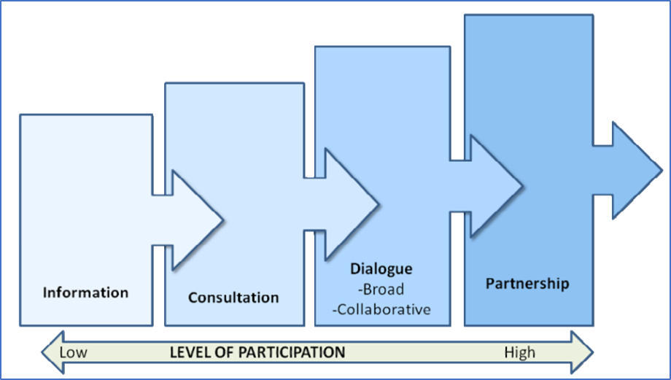
Levels of Participation

Slide 45
Interesting note…
“SPCs need to be involved from the preliminary phases of preparation of a policy and to assist in the setting of overall parameters, identification of issues to be addressed and approaches to be taken etc.
In this way, SPC members can have a meaningful involvement in presenting to the full council for decision the values and choices which are important elements of plan preparation.”
Circular LG 07/2014

Slide 46
Thank You

