Slide 1
Session 2: Individual Committees
Susanne Rogers
Research and Policy Analyst
Social Justice Ireland
Notes:
Hello and welcome to today’s session, An Introduction to PPNs. My name is Seán Healy, CEO of Social Justice Ireland.

Slide 2
So – what’s going to be covered?
Section 1: Committees
Section 2: Effective Representation
Notes:
So, what’s going to be covered today? The first thing we’re going to look at is what the PPN is, what it’s role is, it’s structure and a little bit about who the stakeholders are. After this presentation, there’ll be a little quiz – but don’t worry, it should be painless enough!
The second section will be about the purpose and benefits of the PPN and how meaningful engagement between the PPNs and the Local Authorities can be really beneficial

Slide 3
Section 1:Role of Committees and Sligo PPN
Notes:
So let’s get started!

Slide 4
What are Local Committees?
Established by the Local Authority or other State body
Bring a “community voice” to local government decision-making
Ultimate policy decisions taken by whole Council
Notes:
So how do we get to Partnership in decision-making? Well, for a start it can help to know what the Local Committees broadly are and what the Committees in Carlow actually do.

Slide 5
Committees’ Responsibilities
To have and communicate a clear terms of reference and procedures / standing orders and vision for the committee.
To hold regular meetings at times, dates and locations that facilitate the participation of volunteers. Ideally these dates should be set annually.
To hold an induction meeting and have an induction pack for new members to explain the processes and procedures of the committee.
To set the agenda in consultation with members and to enable members to place items on the agenda.
To give one month’s notice of meetings and to circulate the agenda and any documentation for reading at absolute minimum two weeks in advance. This is to facilitate PPN members to consult with their linkage group before the meeting, and to ensure that members have adequate information with which to make comments and decisions.
To chair the meeting in an open and transparent way as to enable and value the contribution of all members and fosters a culture of active listening. This should include giving enough time for discussion and deliberation of items, and if required setting up subgroups to bring recommendations to the main committee. Decisions should be made in an open and transparent way.
Notes:
The way in which the Committee conducts its business has a huge impact on the effectiveness of Tipperary PPN representation. An overformal and rigid process can make participation difficult. The following rights and responsibilities are generally within the remit of the Chair or Chief Officer (or equivalent). The majority are likely to be already in place.

Slide 6
Committees’ Responsibilities
To ensure that any conflicts of interest are clearly stated and dealt with appropriately.
To include all points of discussion within the minutes, and not to dismiss those which may be considered “only relevant to a few”. To produce an agreed “meeting outcome” document at the end of each meeting which can be shared with the Linkage Group.
To pay travel and other expenses to members.
To offer relevant training to all members and to provide support to members in interpreting technical documents.
To review the workings of the committee on a regular basis and to take on board any recommendations.
Notes:
The way in which the Committee conducts its business has a huge impact on the effectiveness of Tipperary PPN representation. An overformal and rigid process can make participation difficult. The following rights and responsibilities are generally within the remit of the Chair or Chief Officer (or equivalent). The majority are likely to be already in place.

Slide 7
Committees’ Rights
Members will attend meetings, or send their alternate (where possible).
Members will prepare thoroughly for meetings, and be able to contribute fully.
Members will feed back to their PPN Linkage groups and take direction from them.
Members will take a full part in the workings of the committee including participation in subgroups, consultations etc.
Members will be open and honest in their dealings with the committee, declaring any conflicts of interest.

Slide 8
Committees
Local Community Development Committee
Local Community Development Committee
North West Fisheries Local Action Group
Independent Evaluation Committee
North West Fisheries Local Action Group
Independent Evaluation Committee
Housing and Corporate SPC
Housing and Corporate SPC
Environment and Infrastructure
Environment and Infrastructure
Sligo Leader Partnership Company
Public Arts Steering Committee
Disability Consultative Committee
Public Arts Steering Committee
Disability Consultative Committee
Sligo PPN
Climate Change
Climate Change
Planning, Community & Economic Development, Arts and Culture
Planning, Community & Economic Development, Arts and Culture
Sligo Sport & Recreation Partnership
Place Names Committee
Sligo Sport & Recreation Partnership
Place Names Committee
Joint Policing Committee
Heritage Forum
Joint Policing Committee
Heritage Forum
Notes:
So, these are the Boards and Committees on which Carlow PPN have Representatives. You have:
Local Community Development Committee
Planning, Environmental, Climate and Biodiversity Action, Energy and Agriculture SPC
Culture, Libraries and Digital Development, Tourism, Enterprise and Economic Development SPC
Transportation and Infrastructure SPC
Housing, Community and Wellbeing SPC
Joint Policing Committee
Carlow Town Development
Carlow Tourism
South East Region Drugs and Alcohol Task Force
You can tell just from the names that these committees cover a very broad range of policy areas, Representatives elected to these Committees will have a wide brief and sometimes a difficult job in trying to get the PPN issues on the agenda, and so it’s important that they’re supported as much as possible by the Linkage Groups. The more knowledge they have of the issues emerging for PPN Member Groups, the more they can speak with authority, the greater chance they have of being heard.

Slide 9
Local Community Development Committee
To prepare, adopt, implement, monitor and review the community elements of a 6 year Local Economic and Community Plan.
To consider and adopt a statement of the economic elements of the Local Economic and Community Plan.
To improve the co-ordination of publicly funded programmes including the Local Community Development Programme Rural Development Programme (LEADER) and Social Inclusion Community Activation Programme (SICAP).
Oversight of local and community development programmes
Local Community Development Committee
Notes:
Overall, the Local Community Development Committee, or LCDC for short, is a Local Authority Committee with public and private members which oversees community development programmes in an area including LEADER and SICAP. An LCDC must have at least 5 members elected through the PPNs – 2 Social Inclusion, 2 Community and Voluntary; and 1 Environmental. There should also be a majority of one non-public members compared to public members. The aim of LCDCs is to develop, coordinate and implement coherent and integrated approaches to local and community development.

Slide 10
Joint Policing Committee
Joint Policing Committee
Communications and Effective Engagement
Community Policing & Rural Isolation
Crime Prevention and Education
Road Safety
Public Safety
Joint Policing Committee
Notes:
The Joint Policing Committees were established under a 2005 Act, so they predate the SPCs. The Garda Siochána Act of 2005 states The JPC’s function is to serve as a forum for consultations, discussions and recommendations on matters affecting the policing of the Local Authority administrative area and lists certain areas of particular focus. These areas have been worked into Carlow County Council’s JPC Strategic Plan as
Carlow PPN has 6 Reps on the JPC.

Slide 11
Heritage Forum
Heritage Forum
Encompasses all aspects of heritage in the county, both built and natural.
Feeds into the County Heritage Plan
To create awareness and appreciation of Sligo’s Heritage
To care for and enjoy Sligo’s Heritage
Heritage Forum
Notes:
The Carlow Town Development Forum was established to oversee and direct the implementation of a Town Centre Action Plan during 2018.
The Vision of the Carlow Town Development Forum was to improve the prosperity of the Town Centre and enhance the well-being of the community, creating a viable and sustainable Town Centre economy.
The aim of the Forum is to revitalise the Town Centre by supporting the development of a broad mix of retail, community and leisure uses that create a distinct Town Centre, appealing to residents and visitors alike.
Carlow PPN has 1 Rep on this Forum.

Slide 12
Place Names Committee
Place Names Committee
Creating an awareness and appreciation for the traditional names of over 1,300 townlands
Naming of new developments
Interpretation of existing place names
Advising on the changing and display of area names as per Part 18 of the Local Govt. Act, 2001
Place Names Committee
Notes:
Carlow Tourism was established to promote Carlow as a tourist destination. These promotions have as broad a range as Carlow has things to offer – from local accommodation, restaurants and pubs, to amenities, sports and historical attractions. Carlow PPN has 1 Representative on this Board

Slide 13
Sligo Sport and Recreation Partnership
Aims to support increased participation in sport and active recreation by ensuring there is a broad range of opportunities for everyone
Provide assistance in the areas of sports development, education and training and general information on sporting activities.
Work in partnership with sporting clubs, community organisations and local agencies
Sligo Sport & Recreation Partnership

Slide 14
Disability Consultative Committee
Disability Consultative Committee
Disability proofing
Advocacy on behalf of people with disability
Raising Awareness – Information Provision
Disability Consultative Committee
Notes:
.

Slide 15
Independent Evaluation Committee
The Independent Evaluation committee (IEC) assesses and evaluates proposals and projects for funding and comprises a panel of individuals offering expertise from appropriate sectors in accordance with the LDS and the LEADER Operating Rules.
Independent Evaluation Committee

Slide 16
North West Fisheries Local Action Group
North West Fisheries Local Action Group
Caters for Counties Mayo and Sligo – from Killybegs to Mullaghmore – 9km out from the coast.
It was allocated €1.5m for 2016 -2020 from the European Maritime & Fisheries Fund for projects in the Coastal region of the North West
North West Fisheries Local Action Group

Slide 17
Public Arts Steering Committee
Public Arts Steering Committee
Public Arts Steering Committee

Slide 18
Section 2: Effective Representation

Slide 19
Effective Representation = Making Connections
Area of Interest / Concern / Issue
Local Area Development
Civic Engagement
Planning and Infrastructure
Environmental Protection
Heritage
Tourism
Community Safety
Community Support
Vulnerable Groups
Local Economy
Rural Development
Housing
Recreation / Sports
Education and Training
LA Budget
Committee / Board
LCDC
Environment and Infrastructure
Planning, Community, Economic Development, Arts & Culture
Climate Change
Housing and Corporate
Joint Policing Committee
Sligo Sports & Recreation Partnership
Disability Consultative Committee
North West Fisheries LAG
Heritage Forum
Place Names Committee
Sligo Leader Partnership Company
Public Arts Steering Committee
Independent Evaluation Committee

Slide 20
Effective Representation = Making Connections
Area of Interest / Concern / Issue
Local Area Development
Civic Engagement
Planning and Infrastructure
Environmental Protection
Heritage
Tourism
Community Safety
Community Support
Vulnerable Groups
Local Economy
Rural Development
Housing
Recreation / Sports
Education and Training
LA Budget
Committee / Board
LCDC
Environment and Infrastructure
Planning, Community, Economic Development, Arts & Culture
Climate Change
Housing and Corporate
Joint Policing Committee
Sligo Sports & Recreation Partnership
Disability Consultative Committee
North West Fisheries LAG
Heritage Forum
Place Names Committee
Sligo Leader Partnership Company
Public Arts Steering Committee
Independent Evaluation Committee

Slide 21
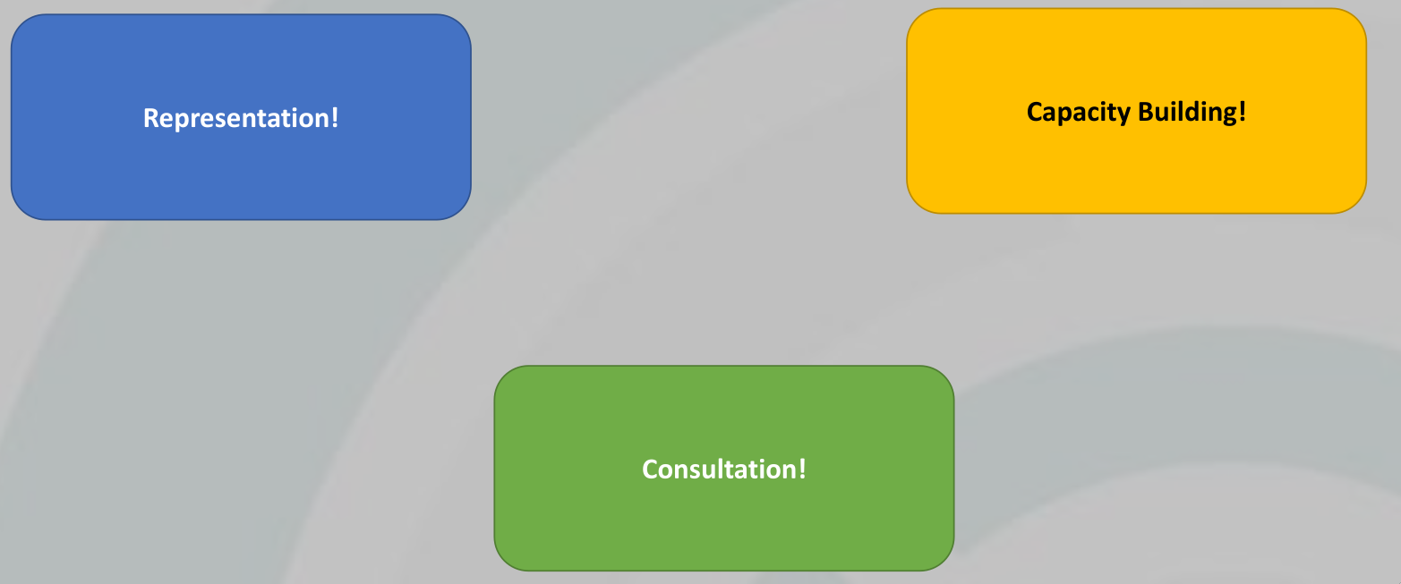
How can the PPN influence Policy?

Slide 22
Strategic Aspects of Participation
Start with the Agenda Issue Know your mandate Do your research Network Engage

Slide 23
Start with the Agenda/Issue
Start with the Agenda/Issue
Who sets it? Who feeds into it? What are the priorities?

Slide 24
Know your mandate – Linkage Groups/Thematic Networks Plenary Vision for Community Wellbeing Do your research- What do I know? Need to know? How do I find out?

Slide 25
Network – Build relationships Get different perspectives Challenge (constructively) Engage- Participate Be open Suggest and share

Slide 26
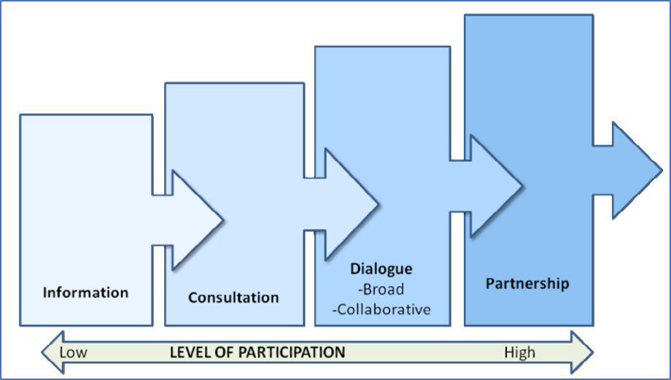
Levels of Participation

Slide 27
Example – Information Stage
The Council has decided to grant planning permission for a shopping centre on the outskirts of the town. Due to new planning regulations, this was fast-tracked through without consultation.
The Council thought that this might help alleviate traffic congestion and be better for the environment. It might also provide good jobs for people in more remote areas.
What Committee or Committees might be interested in this issue?
LCDC
Environment and Infrastructure
Planning, Community, Economic Development, Arts & Culture
Climate Change
Housing and Corporate
Joint Policing Committee
Sligo Sports & Recreation Partnership
Disability Consultative Committee
Heritage Forum
Place Names Committee

Slide 28
Example – Consultation Stage
The shopping centre idea has received a lot of bad press. The Council still wants to go ahead with it, but realises that it should have some public input. They publish a consultation.
The consultation takes the form of a plan of the shopping centre, a statement that money has been spent on the land, so it has to be built on the site, and an online form asking specific questions about what it should contain.
What’s the benefit of this approach
For the Council?
For the public / PPN?
What’s the disadvantage of this approach
For the Council?
For the public / PPN?

Slide 29
Example – Dialogue Stage
The consultation didn’t work. People were very angry about the use of the site and protested the building works.
The Council have agreed to meet with the relevant Committees to discuss the development.
They’ve circulated an agenda for the meeting.
What’s the benefit of this approach
For the Council?
For the public / PPN?
What’s the disadvantage of this approach
For the Council?
For the public / PPN?

Slide 30
Example – Partnership Stage
Following the meeting, the Council have decided to start again.
They have a budget to develop a state of the art shopping facility with the aim of creating jobs, supporting communities, and working towards a cleaner environment.
With the exception of the budget, they want to work with all stakeholders in the area to come up with a workable plan. Everyone will have an input and all with work collaboratively together.
What are the advantages and disadvantages of this approach?

Slide 31
Positive Representation on a Committee
Know what the Committee can and cannot do
Manage expectations
Be clear on what you want the Representative to achieve at each meeting
Listen and learn
Make specific input
Influence others on specific topic
Network
Set agenda
Be constructive
Build alliances

Slide 32
Recap
Representation on Committees give a voice to communities
It’s important to understand shared areas of interest / concern – the more voices across more Committees, the greater the possibility of change
Being a Representative is a key role for the PPN – it comes with Responsibilities and Rights
Engagement is crucial to get the job done

