Slide 1
On Reaching a Fork in the Road

Slide 2
AGENDA
Membership
Progress Update
Immediate Future
Longer Term

Slide 3
Notes:
The Alliance brings together 47 civic and business organisations from across Ireland, representing over 55,000 members, 700,000 employees, 622,000 volunteers and 374,000 students in highlighting the negative impact of persistently high premiums and calling for real reforms that will quickly reduce liability and motor insurance premiums to affordable levels and keep them that way.

Slide 4
PROGRESS UPDATE
Judicial Guidelines
Reductions from insurers
Availability
Sub Group on Insurance Reform
Duty of Care
PIAB reform
Garda Unit

Slide 5
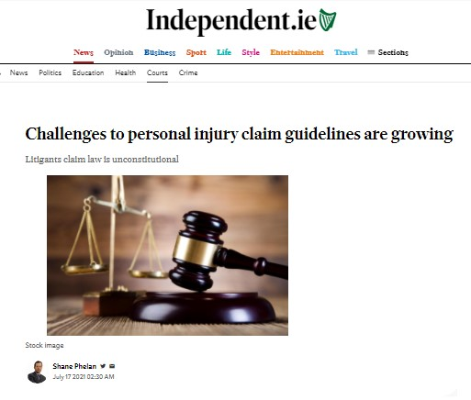
PROGRESS UPDATE
Judicial Guidelines
Reductions from insurers
Availability
Sub Group on Insurance Reform
Duty of Care
PIAB reform
Garda Unit

Slide 6
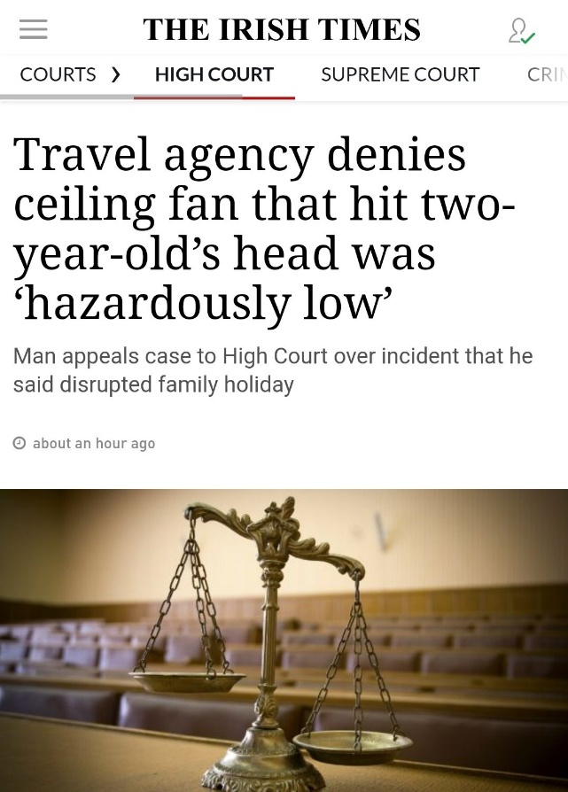
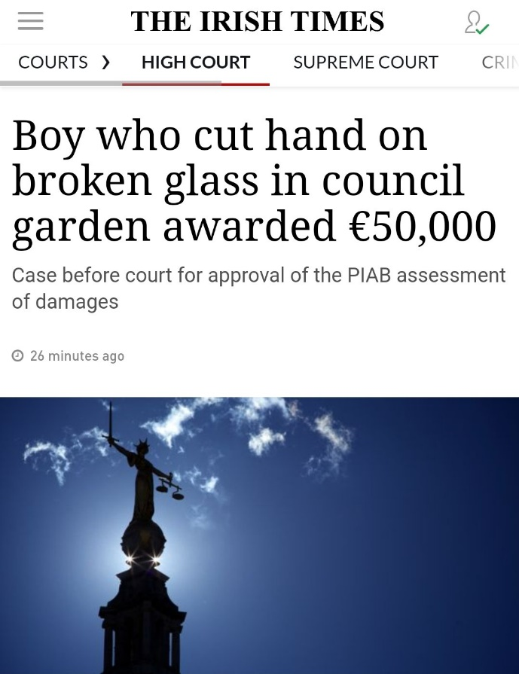
PROGRESS UPDATE
Judicial Guidelines
Reductions from insurers
Availability
Sub Group on Insurance Reform
Duty of Care
PIAB reform
Garda Unit

Slide 7
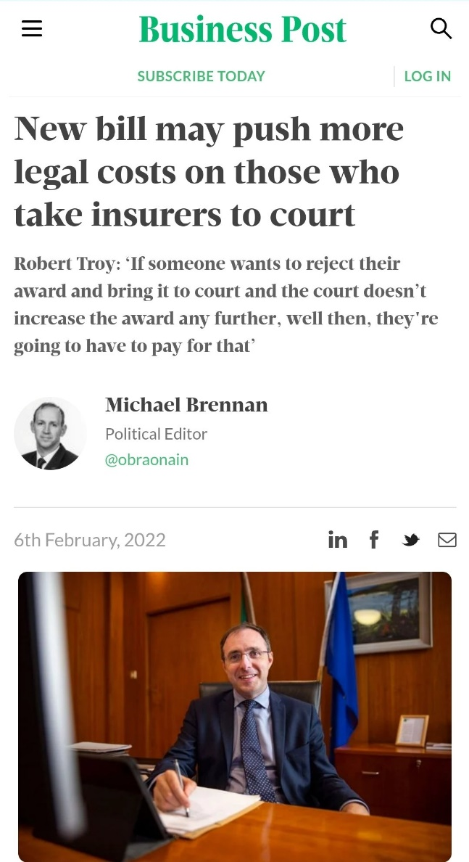
PROGRESS UPDATE
Judicial Guidelines
Reductions from insurers
Availability
Sub Group on Insurance Reform
Duty of Care
PIAB reform
Garda Unit

Slide 8
PROGRESS UPDATE
Judicial Guidelines
Reductions from insurers
Availability
Sub Group on Insurance Reform
Duty of Care
PIAB reform
Garda Unit

Slide 9
PROGRESS UPDATE
Judicial Guidelines
Reductions from insurers
Availability
Sub Group on Insurance Reform
Duty of Care
PIAB reform
Garda Unit

Slide 10
PROGRESS UPDATE
Judicial Guidelines
Reductions from insurers
Availability
Sub Group on Insurance Reform
Duty of Care
PIAB reform
Garda Unit

Slide 11
PROGRESS UPDATE – OTHER REFORMS
Legal costs
Insurance fraud database
Complaints regarding legal practitioners

Slide 12
IMMEDIATE FUTURE - 2022
Group Schemes
Risk Management
Normalisation of high premiums
Victory parade

Slide 13
LONGER TERM
Damages
Defamation
Legal fees
Duty of care

Slide 14
RIGHT NOW
Grassroots campaign

Slide 15
THANK YOU
FINAL Q&A

Slide 16
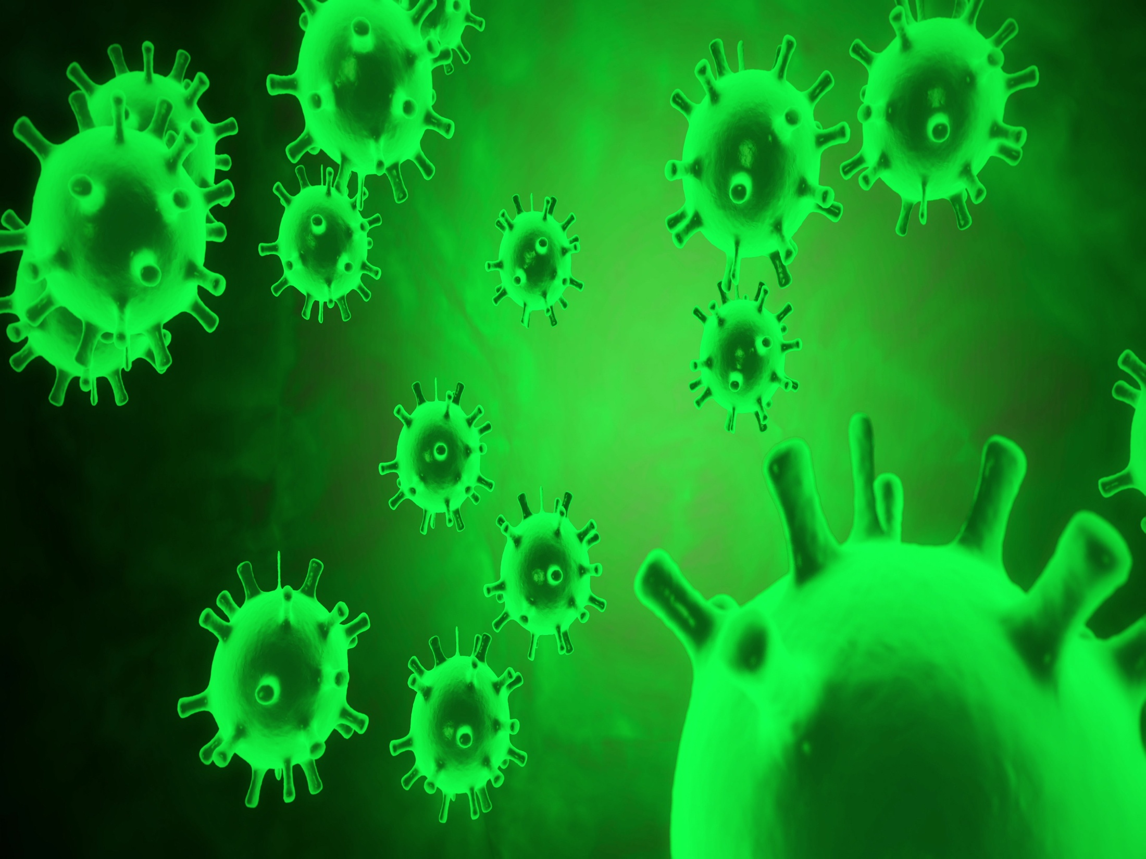
COVID19
Business interruption
Personal injury claims?
Questions?
Rebates

