Slide 1
Support for Sligo PPN community members
Being Funding Ready
Notes:
Course set-up
Distribution of slide handouts.
Introduction of presenters and participants.
Introduction to:
Course duration
Form of presentation
Discuss assessment procedure

Slide 2
Why
In every single needs analysis conducted by Sligo PPN, the call for support in sourcing funding and completing application forms emerges as the number one priority.
While the funding climate in Ireland is complex – grants are often announced with very little notice and each application form is different with little standardisation – we hope that this guide, along with our other support documents at https://www.sligoppn.com/how-to-apply-for-funding, help you a bit.

Slide 3
What kind of structure do we need?

Slide 4
Management Structures How should our group be set up to best support our overall aim?
There are 2 main types of structures used by community groups:
Association
Limited company
Two other types include:
Trust
Co-operative

Slide 5
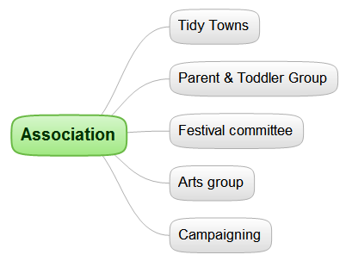
Association
Legally, the people are the association.
A committee is formed to run and manage the organisation

Slide 6
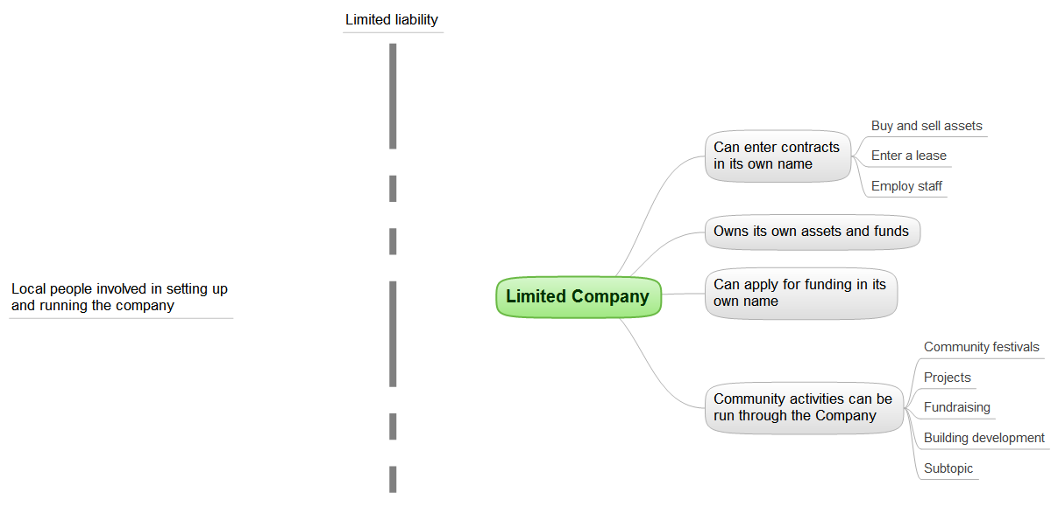
Limited company

Slide 7
Limited company
Members set up the company
Members vote in Directors at the AGM
Directors run the company
Company limited by guarantee - CLG
In most cases, a Management Committee is appointed by the Directors to run the company, which can be comprised of:
Members, directors or a mix of both
A mix of members, directors and other individuals
Other individuals, none of whom are members or directors

Slide 8
Committees
In the case of both Associations and Limited Companies, a Management Committee is formed
The Management Committee has responsibility for running the company or association effectively
For a CLG, the management committee may be separate from the Board of Directors
If required, the Management Committee can form sub-committees to carry out specific task (see later)

Slide 9
Subcommittees
Examples include:
Funding applications and fundraising
Building projects, dealing with contractors, architects
Dealing with employee grievances
Subcommittees should be give a very specific remit, i.e. write a short Terms of Reference for the subcommittee
People appointed to the Subcommittee
Lead person for the Subcommittee
Authority, e.g. decisions, money, publicity

Slide 10
Management Committee
It is important to have specific roles with the committee:
Chairperson
Secretary
Treasurer
PRO (Publicity)
Staff Liaison Officer

Slide 11
What is a constitution?

Slide 12
Constitution
What is the constitution for:
A company?
An association?
A company needs a constitution to be set-up
What is it?
Where is it?
An Association needs to write its own Constitution

Slide 13
Constitution for an association
Date of Constitution
Name of Association
Objectives for the association
Powers of the Committee
To achieve the objectives of the Association, the Committee have the following powers
Membership
Membership of the Association can be achieved by fulfilling the following criteria
Meetings
General frequency for all meetings, including AGM and general meetings, are as follows
Committee
The Committee will be elected according to the following rules
Committee Decision

Slide 14
Constitution for an association
Quorum
The number of Committee Officers required to form a quorum for meetings at which a vote is being held
Removal of Officers and Members
Committee Officers
The Committee Officers will be comprised of the following posts
Policies and Procedures
The Association will adhere to all relevant policies and procedures prepared and implemented by the Committee
Dissolution
If dissolved, all monies, equipment and assets held on behalf of the Association will be dealt with in the following manner

Slide 15
Vision statement

Slide 16
Vision statement
Prepare a Vision Statement
What do you do?
What do we do?
Don’t underestimate the importance of this step
You DON’T have to use the term Vision or Mission Statement!
Your aims/ objectives should be designed to achieve your Vison Statement

Slide 17
Mission creep
Avoid mission creep
This happens when an organisation loses sight of its overall mission or goal
It takes on as much as it possibly can
It believes that it needs to widen its scope as much as possible to survive
In reality, it reflects a lack of understanding of the real purpose of the organisation
In almost all cases it leads to a poorly managed structure without a CORE purpose

Slide 18
Vision statement
Ask yourself:
Why are we here?
What do we do?
Who do we do it for?
Why do we do it the way that we do?
What image or perception do we want to portray?

Slide 19
Objectives
Your objectives should be aimed at achieving your Vision Statement
Your objectives should be aimed at achieving OUTPUTS and OUTCOMES
Keep your objectives SMART

Slide 20
Need and demand
What is the difference between NEED and DEMAND?
Your Vision statement and Objectives should be based primarily upon…

Slide 21
Logic model
Needs
Outputs
Outcomes
Changes
Vision and objectives

Slide 22
Reporting progress to funders
Outputs
Outcomes
Progress to date

Slide 23
Should we be a charity?

Slide 24
Charities regulator Code
The Charities Governance Code explains the minimum standards a charity should meet to effectively manage and control their charity and is based on legal requirements and best practice.
The following links give you more information on these requirements to help you decide what is applicable for your group.
https://www.charitiesregulator.ie/media/1609/charities-governance-code.pdf
https://www.charitiesregulator.ie/media/2225/complex-and-non-complex-charities.pdf

Slide 25
Impact of being a charity
Tax exemptions
Access to more funding options (at the moment)
Exemptions from filing certain returns
Likely to be limited regarding CRA
Governance requirements likely to be an obligation in a few years
Governance Code
Funding policies and procedures will be required
Applies to Associations and CLGs

Slide 26
Registering a charity
Organisations can now formally register as a charity in Ireland
The registration must take place through the Charitable Regulatory Authority, i.e. CRA
A CHY number is different to a Registered Charity Number

Slide 27
Details required
Charity Details, name, structure, etc.
Charitable purpose
Activities
Addresses
Fundraising
Trustees/ Officers/ Directors
Parent or Subsidiary Organisation
Financial information
Bank accounts

Slide 28
Charitable purpose
A charity is an organisation with a charitable purpose
A charitable purpose is a purpose that is of public benefit and involves:
The prevention or relief of poverty or economic hardship
The advancement of education
The advancement of religion
Any other purpose that is of benefit to the community

Slide 29
Activities
You will need to show:
How your activities directly support your objectives and how you are providing a Public Benefit;
Beneficiaries
Average number of employees
Number of volunteers
Codes signed up to.

Slide 30
Documents and other Info
Copy of Policies and Procedures for risk assessment, etc., for working with children and other vulnerable groups
Financial Information for past 12 months (or since set-up if open for less than 12 months)
Copy of constitution, Memorandum, etc.

Slide 31
Transparency and accountability

Slide 32
New impact of code of governance
Code of Governance:
Leading our organisation, e.g. Plan
Exercising control, e.g. financial controls
Being transparent, e.g. communication with funders
Working effectively, e.g. roles and responsibilities
Behaving with integrity, e.g. declaration of interests

Slide 33
Convene Meetings
Convene general meetings:
Regular meetings
Annual General Meeting
Extraordinary General Meeting
Deals with matters outside normal business conducted at AGM

Slide 34
Holding effective meetings
Many groups are worried about not being able to attract and keep new members
Many also fail to realise that holding effective meetings is very important in this regard
Ineffective meetings are one of the most significant barriers for new members
Personal free time is critical

Slide 35
Holding Effective Meetings
Put simply:
Start on time
Don’t have a meeting unless there is a reason
Have someone in charge (Chairperson)
Call the meeting to order
Have an agenda
Stick to the times agreed (strictly)
Stick to the agenda (strictly)
Sum up points before moving to next agenda item (Chairperson)
Delegate tasks, record what was agreed
Follow-up on what was agreed after the meeting
Finish on time

Slide 36
Summary minutes
Summary minutes are helpful for distributing to the general community and potential members
Edit the detailed minutes, simply, removing any contentious issues
Sometimes they do not have to be edited at all
Summary minutes can be included in:
Newsletter
Community notes
Monthly email
Twitter link
Facebook newsfeed
The aim is to be as open as possible regarding the committee

Slide 37
Annual report
Prepare a short, 1-2 page report describing ALL the achievements and actions:
List all achievements and actions
Give the group the credit it deserves
Publicise the report, e.g. shop front, website, twitter link, Facebook newsfeed
The Annual Report is one of the best sources of information when completing Application Forms
As part of the Governance Code and the CRA, the Annual Report should be on your website

Slide 38
Reporting progress to funders
Outputs
Outcomes
Progress to date

Slide 39
Sources and links
www.ictr.ie
www.governancecode.ie
www.charitiesregulatoryauthority.ie
www.citizensinformationboard.ie
www.revenue.ie

